Slide 1
Cummins Guidanz™ Mobile Immediate Assessment and Guest User Training
Public

Slide 2
Table of Contents
General App Information
Cummins Guidanz
Functionality
Supported Products
Hardware Requirements
Supported Adapters
General Functionality
Basic Functionality
Immediate Assessment

Slide 3
Cummins Guidanz
Guidanz™ is Cummins' new suite of genuine service products, features and capabilities. https://cumminsengines.com/guidanz
Guidanz mobile app includes INSITE like capability and combines everything from diagnostics, training, repair, warranty, metrics and performance feedback
Guidanz app is available for download in US, Canada, Australia, EU (including UK), Mexico, Peru, Columbia, India, and China

Slide 4
Version 5.2.0 Release
What's new:
New features
Calibration import over email
Immediate Assessment for Multi-ECM products
CARB – messages added to ECM Images
Diagnostic Tests:
No New Diagnostic Tests
Advanced Features:
Aftertreatment Maintenance
Fuel Injector Reset
Fuel System Performance Monitor
Maintenance Monitor
Real Time Clock
Engine Abuse History
Idle Shutdown Override
All Features dependent upon the subscriber's user level, and availability in the connected engine
Public

Slide 5
Hardware Requirements
IOS
Bluetooth compatible devices only
iPhone 8, iPad (8th generation), and newer
Minimum space requirements: 1 GB
Recommended space requirements: 2 GB
Android
Minimum OS: Android 7.1 or higher
Bluetooth compatible devices only
Minimum RAM: 2 GB
CPU Architecture: ARMv8-A
64-bit OS and processor only
Minimum space requirements: 1 GB
Recommended space requirements: 2 GB
Public

Slide 6
Download/Installation
Free Download
Android
Search for “Cummins Guidanz” on Google Play
iOS
Search for “Cummins Guidanz” on the App Store
Public

Slide 7
Supported Adapters
INLINE 7
Has Wired/Wi-Fi/Bluetooth, but Guidanz only works in Bluetooth mode
Works with INSITE as well
INLINE Mini
Bluetooth
More information about Adapters
https://www.cummins.com/support/digital-products-and-services-support
How to purchase adapters?
For Cummins internal employees (non-Distributor) go to Ariba, use Non-catalog items and order the part using part number and enter MDC as the supplier
Distributors and dealers can purchase it directly from https://store.cummins.com/
For all others, users need to contact their local distributor

Slide 8
Supported Products
2007 and later Engines
List of unsupported devices is available on the user guide at Here
ADEPT Route Parameter Manager (RPM) Module
For More info
https://www.cummins.com/support/digital-products-and-services-support/adept-support
Note: Currently you do not need a subscription to service the RPM module.

Slide 9
General Functionality

Slide 10
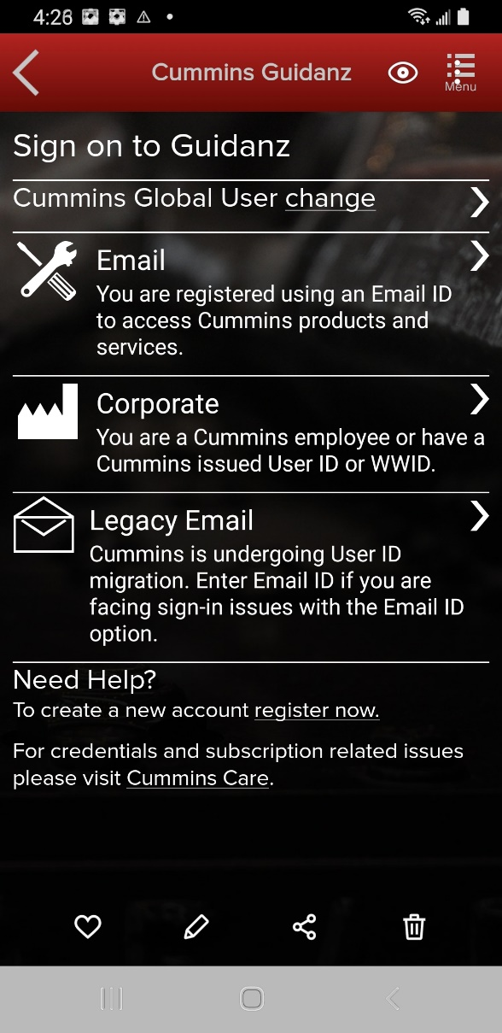
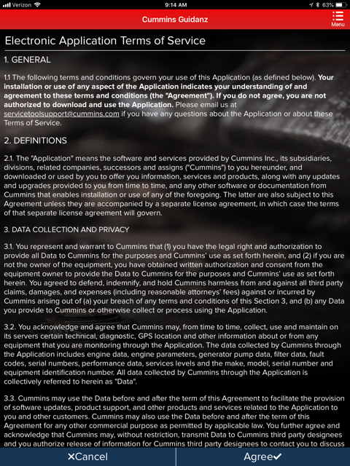
New Log-In Screen
All users need to have a valid Cummins user name and password. If not, users can click on the “register now” link or they can register at https://mylogin.cummins.com/web/IAM_NewRegistration?
Email login for user name in Email format
Corporate login for users with a WWID
Legacy Email login for which Email login does not work
After successful Login users will need to set a PIN code and accept the EULA Terms and Conditions to land on Home page.

Slide 11
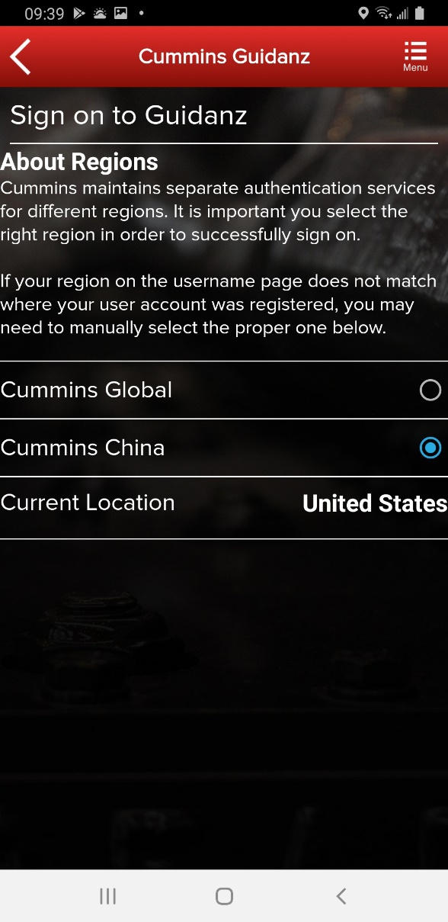
New Log-In Screen
If a user registered in China wants to log into the Guidanz Mobile app, the user needs to change the region by clicking on the change link before login for authentication

Slide 12
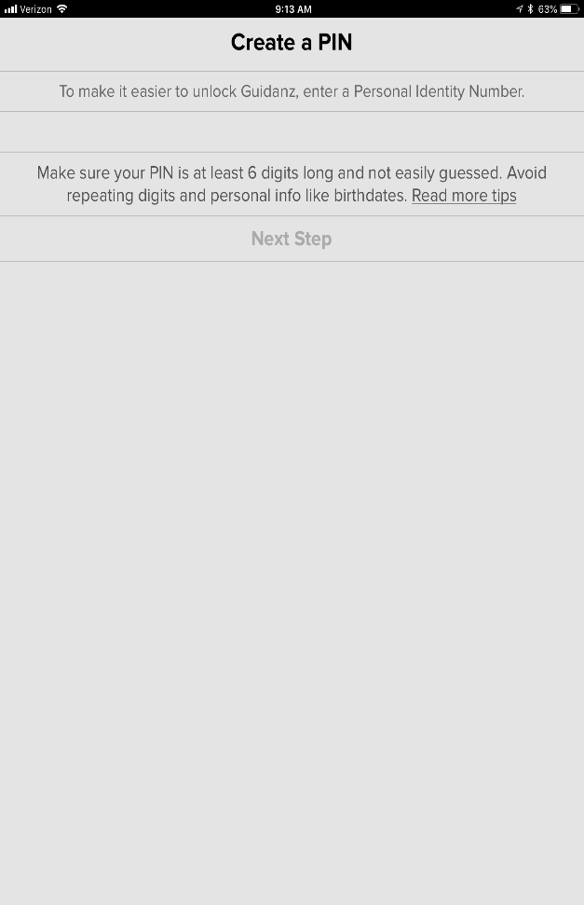
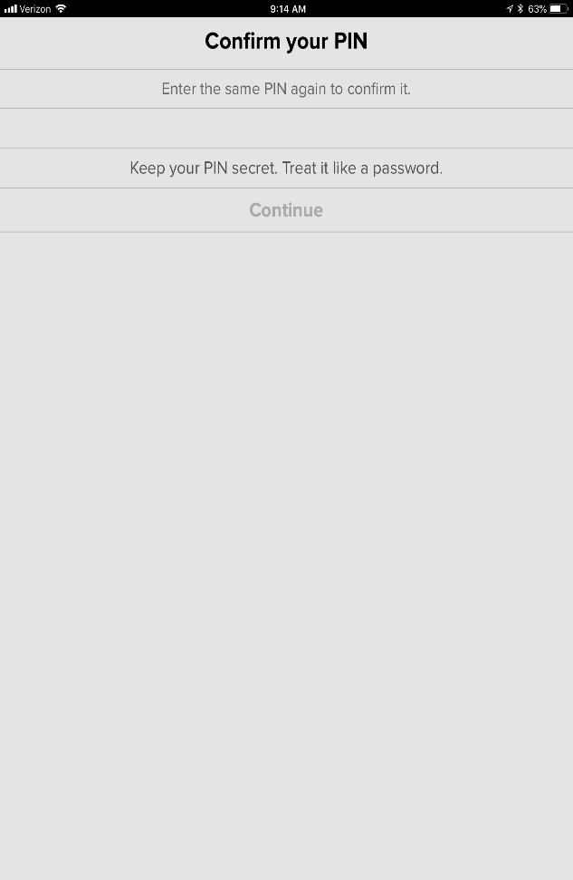
PIN Creation
User is prompted to set a PIN code and then to confirm his/her entry
New PIN security rules
PIN must be at least 6 numbers and can be up to 16 numbers long.
The PIN cannot be an entire sequence of numbers such as 123456 or 654321
The entire PIN cannot be a sequence that simply repeats two digits like 121212
You cannot repeat any single number 4 or more times, such as 000012
Try not to use easily guessed sequences of numbers such as your birthdate, address, or phone number
Public

Slide 13
Subscription Expiration Notification
The app will display a notification of active subscriptions expiring within 14 days and expired subscriptions.
Notes:
Separate line items among screen buttons

Slide 14
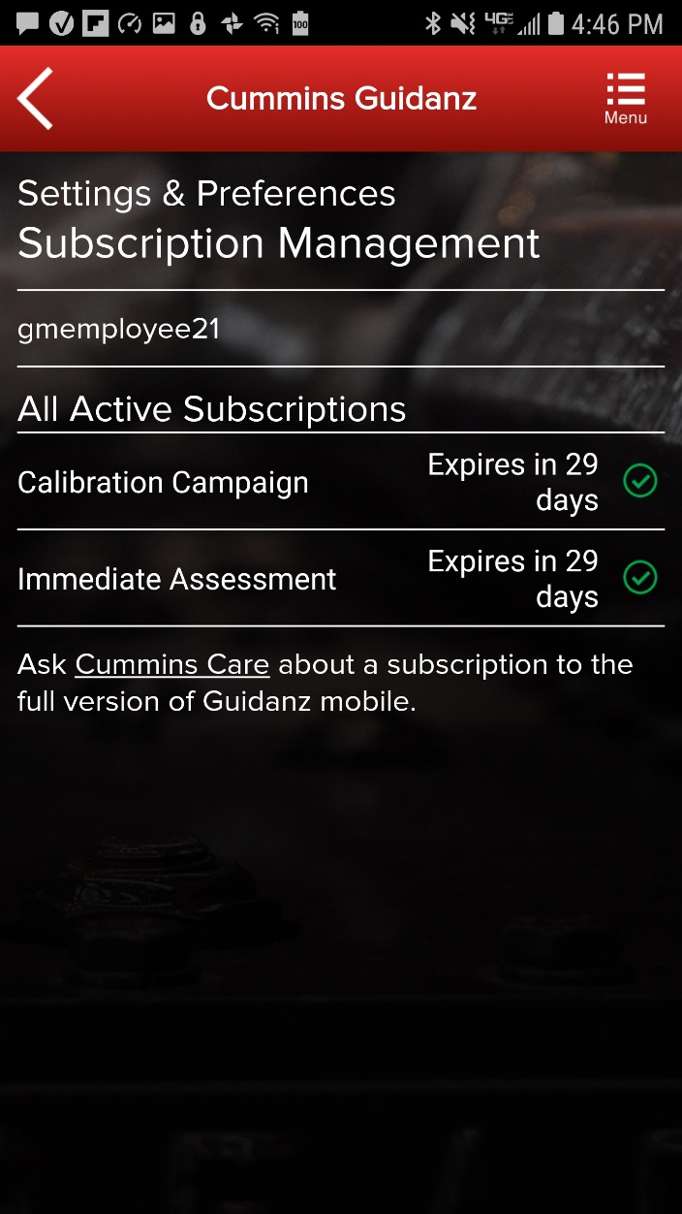
Subscription Management
Subscription Management
The user can see All Active Subscriptions
To access Subscription Management:
Settings & Preferences → Account Management → Select the user under Profiles And Accounts →
Select the User →
Subscription Management

Slide 15
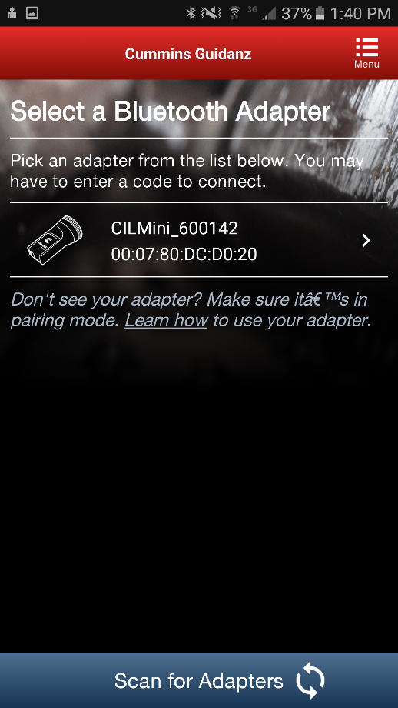
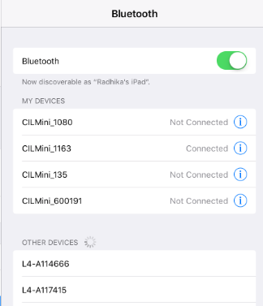
Connecting Adapter to Guidanz
For Initial Pairing, the adapter has to be put on pairing mode
Hold the reset button at the end of the adapter for about 2-3 seconds
The light on the adapter will flash for about 2 minutes
You have to pair it to the device within that time
Subsequent connections
The device would be able to find the adapter without needing to press the button on the adapter
The adapter can be identified by the last few digits of the s/n on the label
Android
Pairing screen is within the app
IOS
Pairing and connection is done on the devices Bluetooth settings window

Slide 16
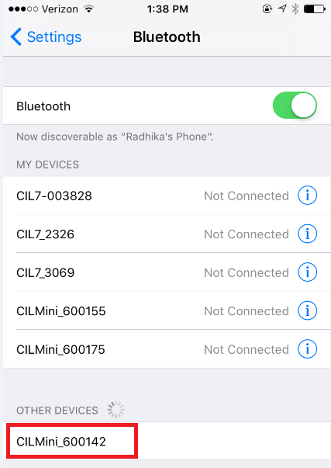
Connecting Adapter to Guidanz
Known Issue
This is not a bug.
App does not auto connect to the adapter.
Unlike some adapters in the market the INLINE 7 and INLINE mini do not auto connect to the mobile device after the initial connection. This is by design to prevent unintended auto connection in locations where multiple users share the adapters.
We are investigating if something can be done to make it easier to the user, while we (Cummins) must keep our security protocol in place.
Android
Pairing screen is within the app
IOS
Pairing and connection is done on the devices Bluetooth settings window

Slide 17
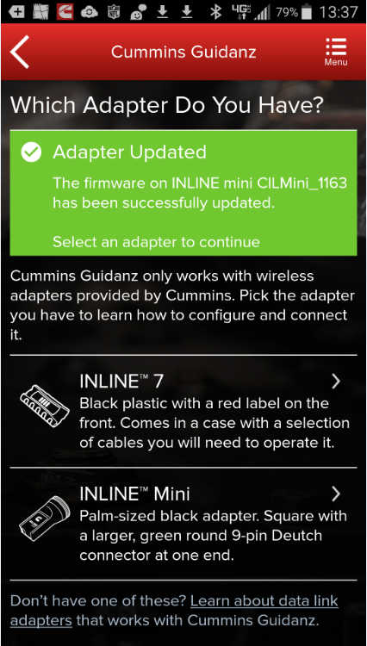
Connecting Adapter to Guidanz
Firmware Update of INLINE Mini
If the firmware of the INLINE Mini needs to be updated, once you have selected the INLINE Mini adapter in the app, the app will automatically update it and display a status update once completed.
If a firmware update has been completed, please be aware that you will have to reconnect again the INLINE Mini.

Slide 18
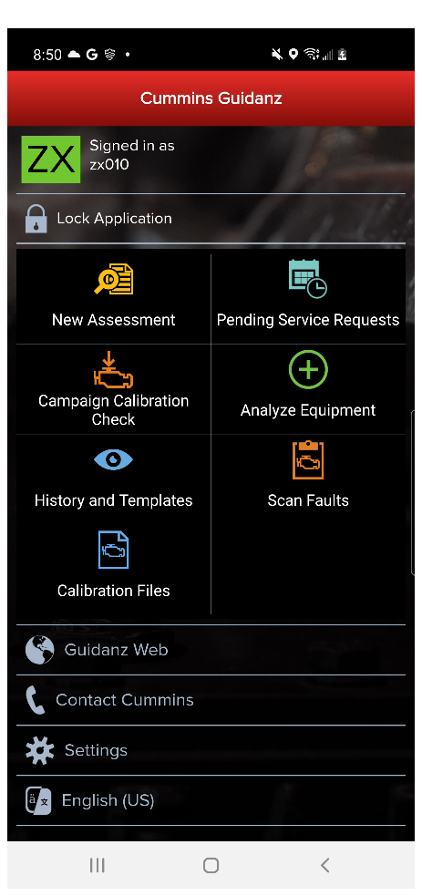
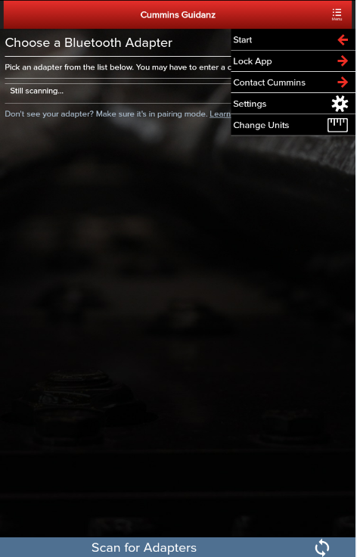
Home Page/Start Page
Another way to get to the Home page is by clicking on Menu → Start while performing any action at which time the Guidanz Mobile app will be disconnected from the ECM.
After logging in, user will see the Home page.
Note: When the user is on the Home Page/Start Page, the Guidanz Mobile app is disconnected from the ECM.
Note: Features displayed on the Home page are dependent upon the user’s subscription level.
Public

Slide 19
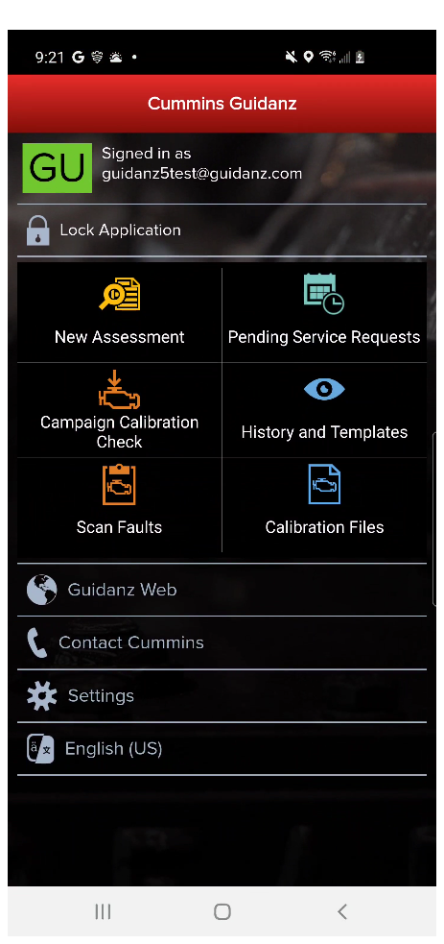
Menu - Settings and Preferences
To access Settings and Preferences:
In the Start page, click on the Settings button
When connected, click on Menu → Settings

Slide 20
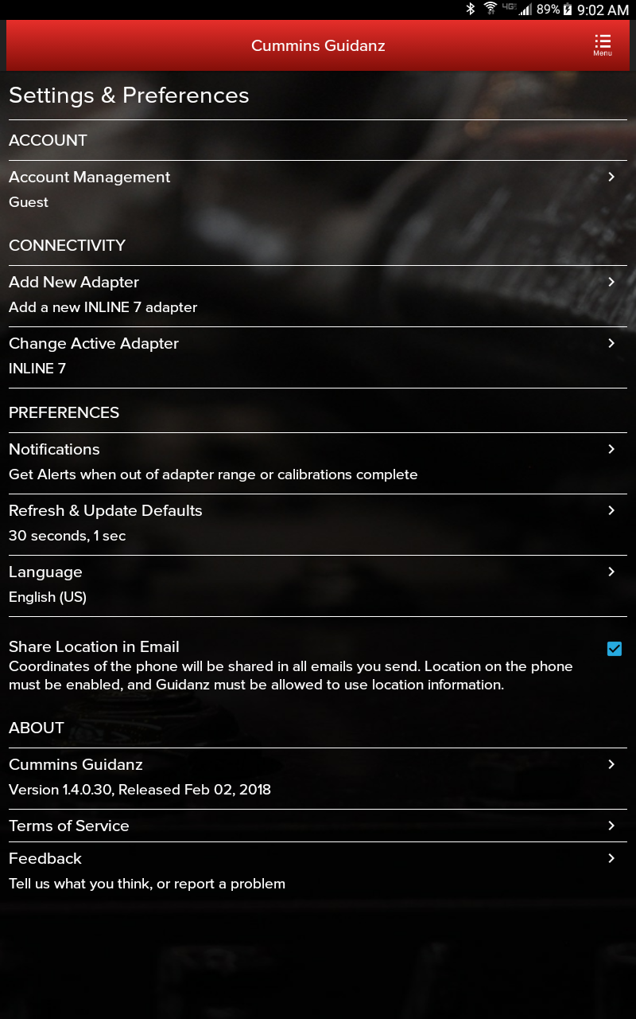
Menu - Settings and Preferences
ACCOUNT
Account Management - Allows user to view subscription status, change pin, remove user profiles, add new users, enable/disable background/foreground locks and time, change PIN
CONNECTIVITY
Add New Adapter - Allows user to add a new adapter
Change Active Adapter - Allows user to add a new adapter
Change Storage Limits – Allows user to change the duration IA records are stored for. By default they are stored for 30 days.
PREFERENCES
Notifications - Allows user to enable/disable onscreen notification when the adapter goes out of range or when a time consuming task(like calibration update) is completed
Refresh & Update Defaults – Allows user to set faults and monitor refresh rates
Language – Allows user to change the language
Share Location in Email – Shares location GPS coordinates in email
ABOUT
Cummins Guidanz link – Shows app version and displays intro screen again
Terms of Service – Shows user the End User License Agreement
Privacy Policy – Allows user to see Cummins Inc. Privacy Policy
Feedback – Allows user to contact servicetoolsupport@cummins.com

Slide 21
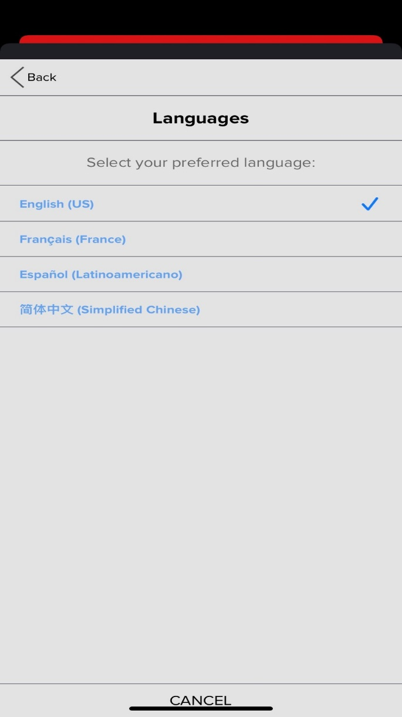
Language Settings
Available languages
English
French
Spanish
Simplified Chinese

Slide 22
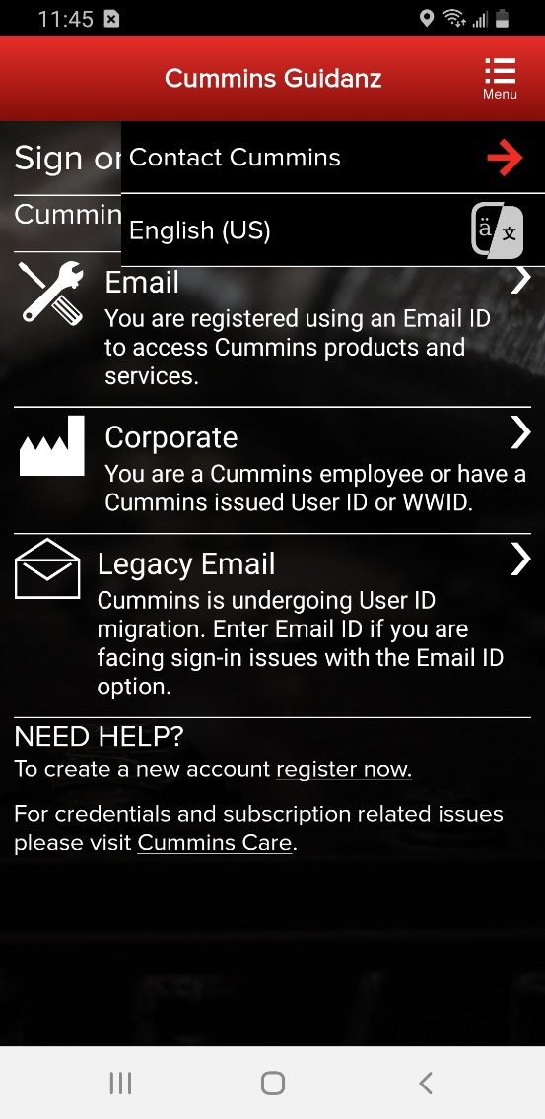
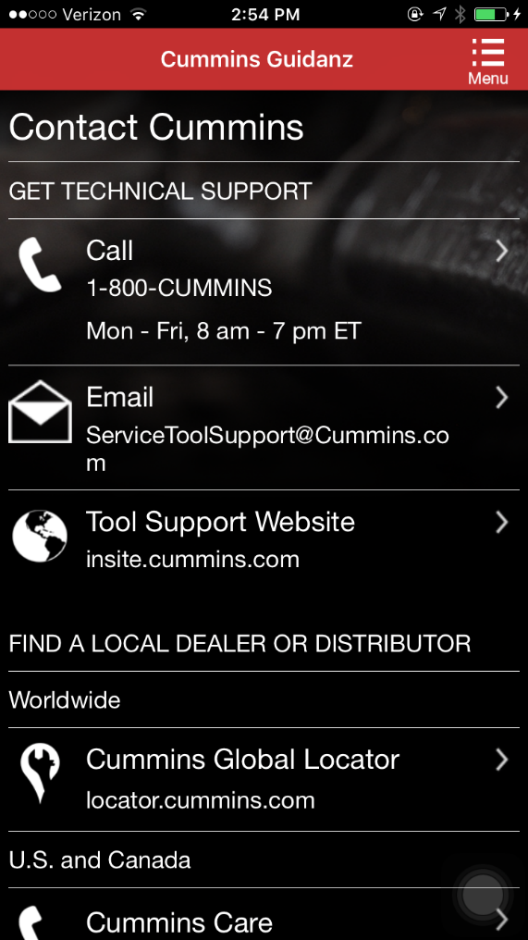
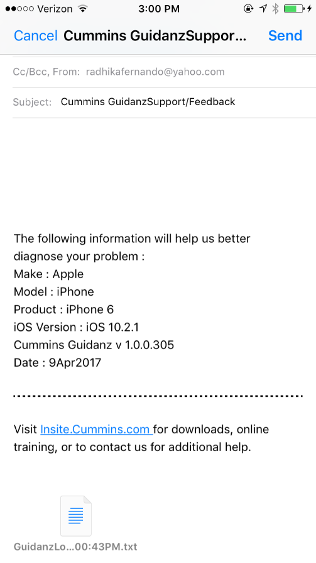
Menu – Contact Cummins/Log File
Allows user to call or email technical support.
In Start page, click on Menu → Contact Cummins.
The email contains device details that will help the support personnel troubleshoot issues.

Slide 23
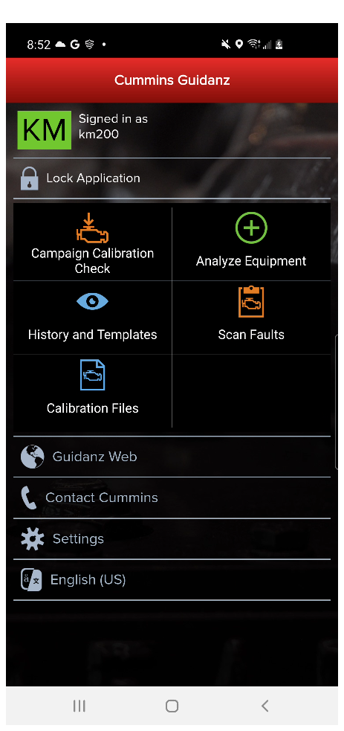
Menu – Contact Cummins/Log File
Or when connected, click on Menu → Contact Cummins → Email
The email contains device details that will help the support personnel troubleshoot issues.

Slide 24
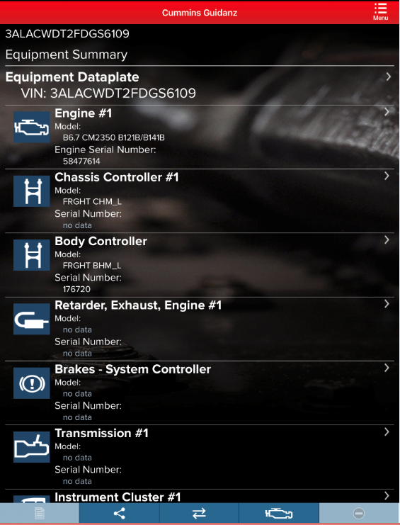
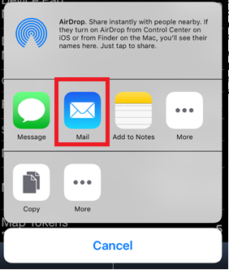
Share Button
User can share the content in the screen via email

Slide 25
Sharing Fault Results
User can click the “Share” button from the Faults screen or from the Immediate Assessment summary page to email the results
Emailing from either page will share the same results
It appends VIN, ESN, and some other information from the Dataplate and individual fault details page so that the user doesn’t need to go to individual pages and email
“Share” button from any other page will email only the content in that page.

Slide 26
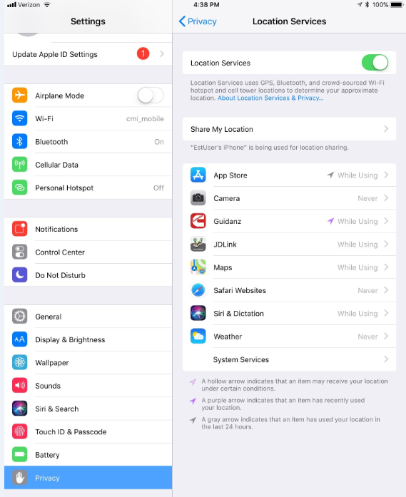
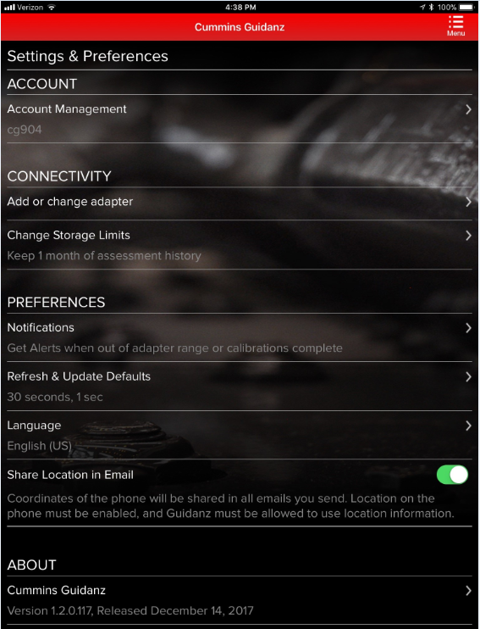
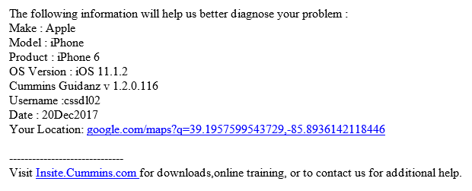
Location
When user selects the Location option in Settings in the device, as well as the Share Location in Email in Settings in the app, the device location will be included in the email.

Slide 27
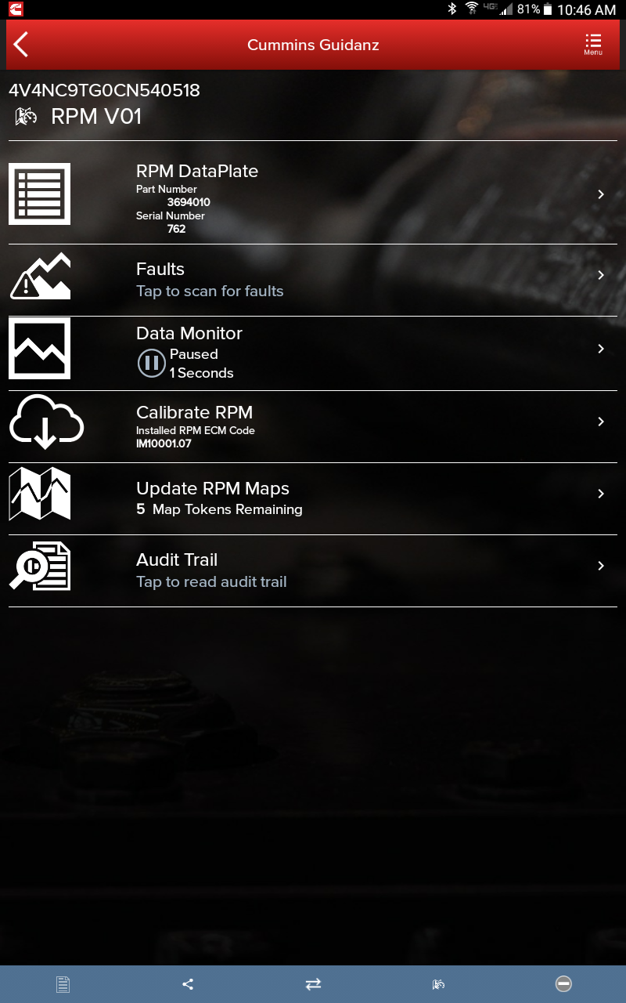
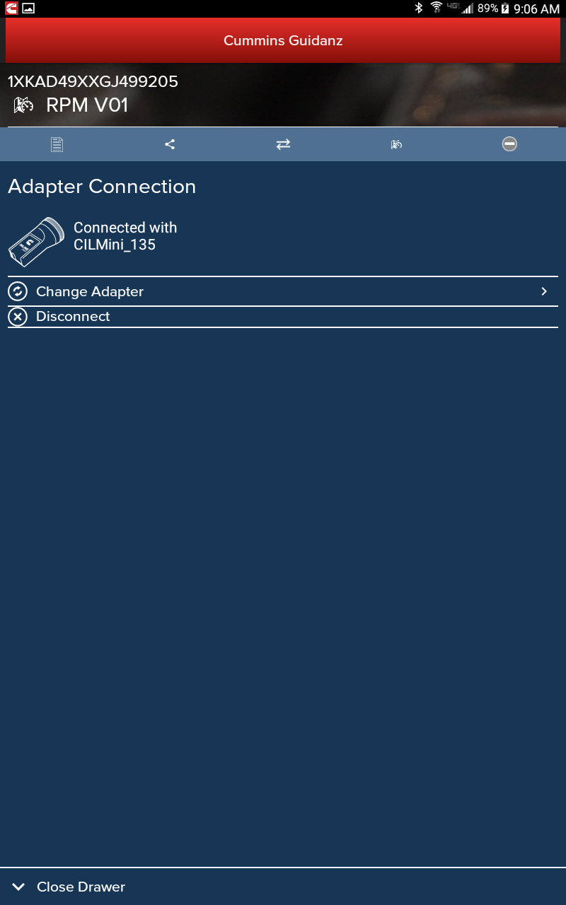
Connection Button
Adapter Tab - Allows user to change adapter or disconnect app from adapter

Slide 28
Manual Refresh
Users can manually refresh the screen by swiping down the screen

Slide 29
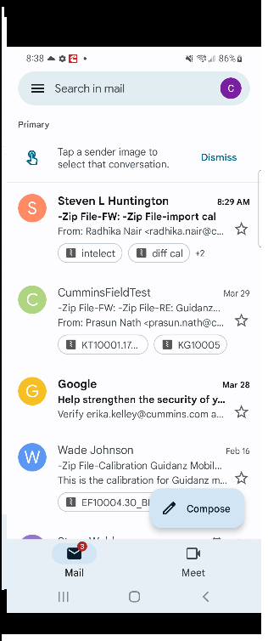
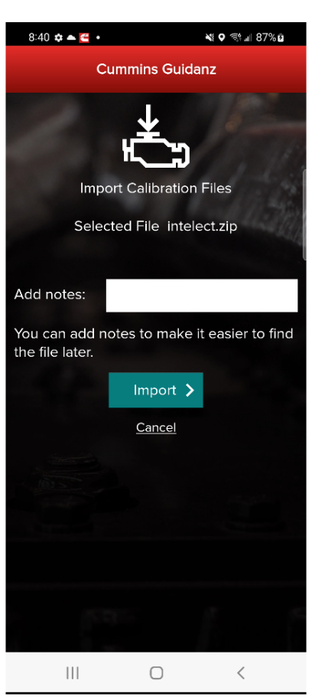
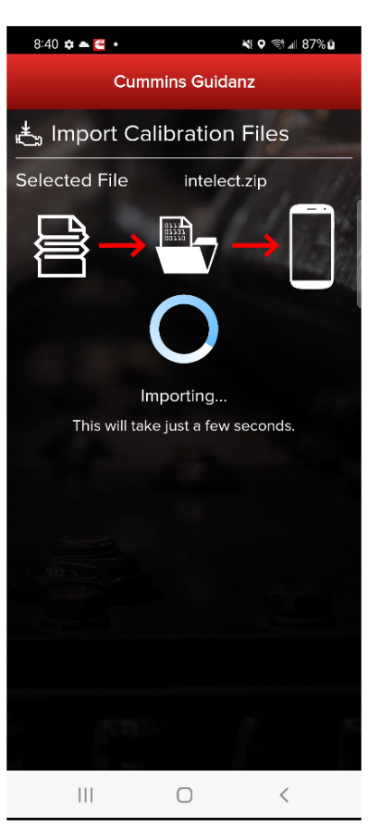
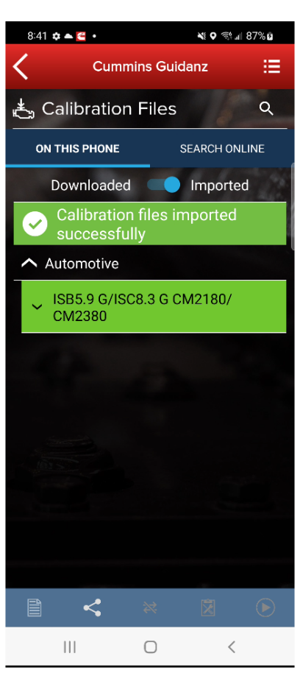
Calibration Import from mail
Compatible calibrations can be imported directly from the mobile device email.
Share the calibration
with Guidanz
to begin the process

Slide 30
Basic Functionality – Guest User

Slide 31
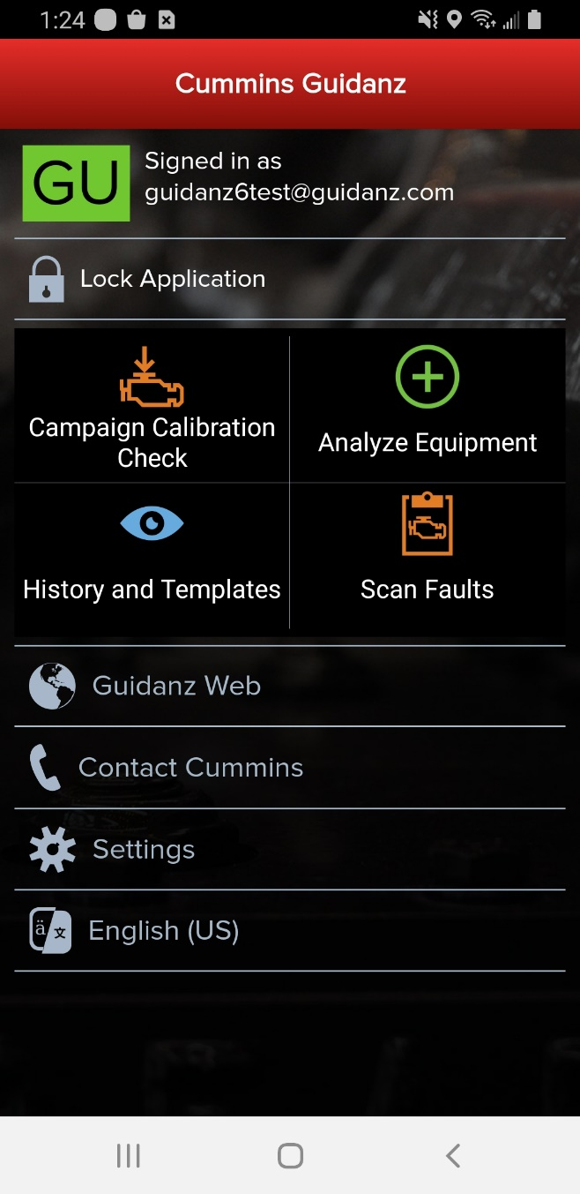
Home Page
Basic Functionality
Campaign Calibration installation capability
"Scan Fault" which is a focused function that can be used to just read the faults from the engine without any fault prioritization.
Enter ESN and customer information
Create Events and View Events
RPM module support
Equipment and device dataplate information
Prioritized Cummins fault codes, and descriptions
Does not apply to multiple ECM engines
J1939 Device Fault
The ability to share any information in the app via email
French, Spanish, Simplified Chinese language support

Slide 32
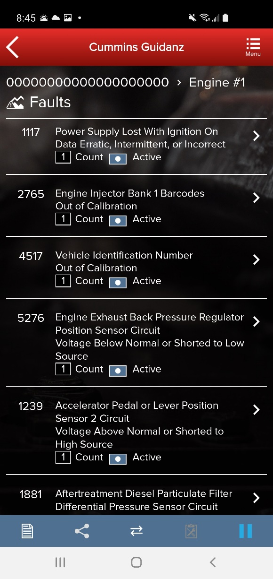
Scan Faults
When selecting Scan Faults the user is taken directly to the Equipment Dashboard
No prioritized fault codes will be displayed
Event folder will be created

Slide 33
Campaign Calibration Installation Through Analyze Equipment
If the user clicks on Analyze Equipment the user will be taken to the ECM Device Dashboard once the user is connected to the ECM.
Public

Slide 34
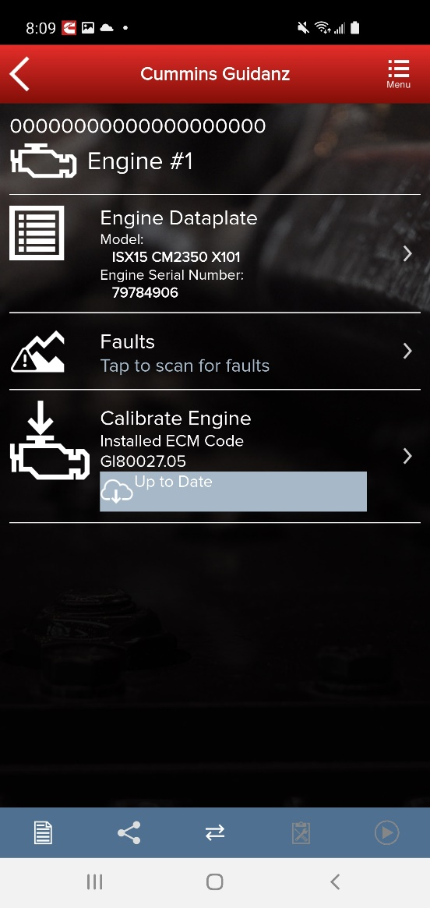
Calibrate Engine
The Calibrate Engine feature on the ECM Device Dashboard will display to the user whether or not the installed ECM code is up to date or whether there is a new revision of the ECM code available.
Does not apply to multiple ECM engines.

Slide 35
Calibrate Engine
If there is a new ECM code available, and the user clicks on the Calibrate Engine feature on the ECM Device Dashboard, the app checks whether the ESN is in campaign and then user will be taken through the process to upgrade to the latest ECM code revision.
Only for an ESN in campaign, if the calibration download fails or the ECM gets rombooted during the calibration download, the user can recover the ECM by going through the pre-defined steps using the same device and user login.

Slide 36
Campaign Calibration Installation
To check for available calibration download, click on the Campaign Calibration Check button which will connect the user to the ECM.
Does not apply to multiple ECM engines.
Public

Slide 37
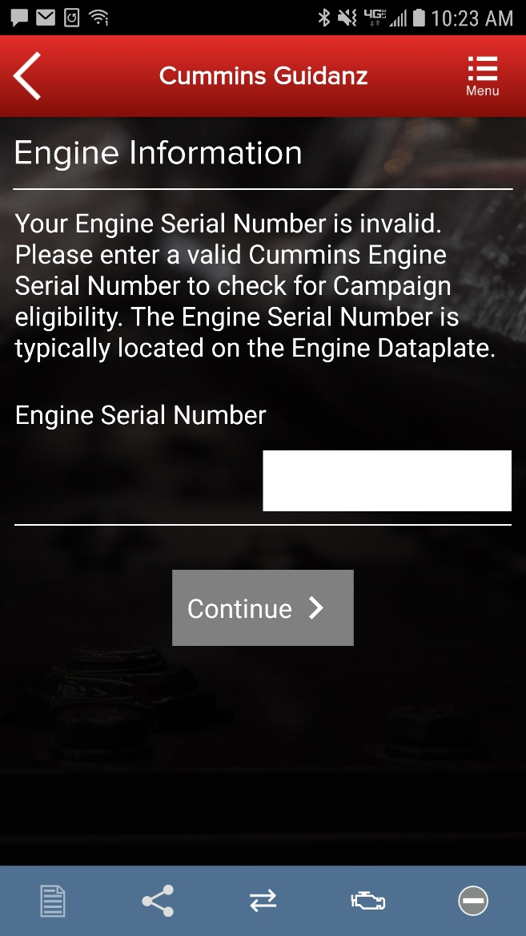
Engine Serial Number (ESN) Eligibility Check
If Guidanz detects an invalid ESN, the user is prompted to enter a valid ESN
Public

Slide 38
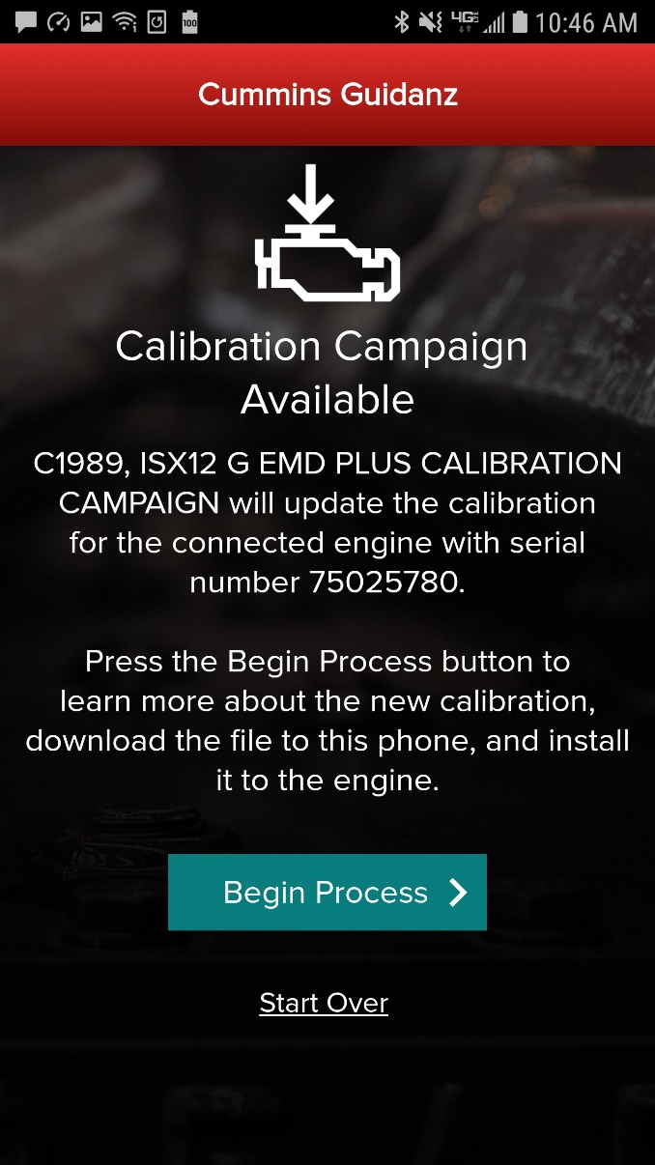
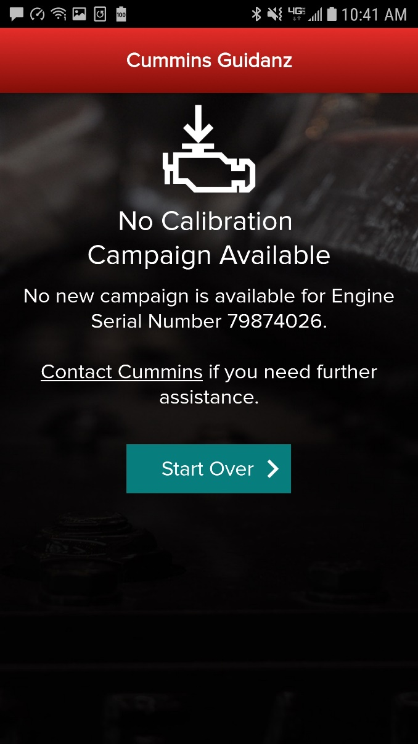
Engine Serial Number (ESN) Eligibility Check
Guidanz mobile will notify the user of the availability or non-availability of a calibration.
If the Engine is not Calibration Campaign eligible, the engine calibration revision can be updated through “Analyze Equipment” path.
Public

Slide 39
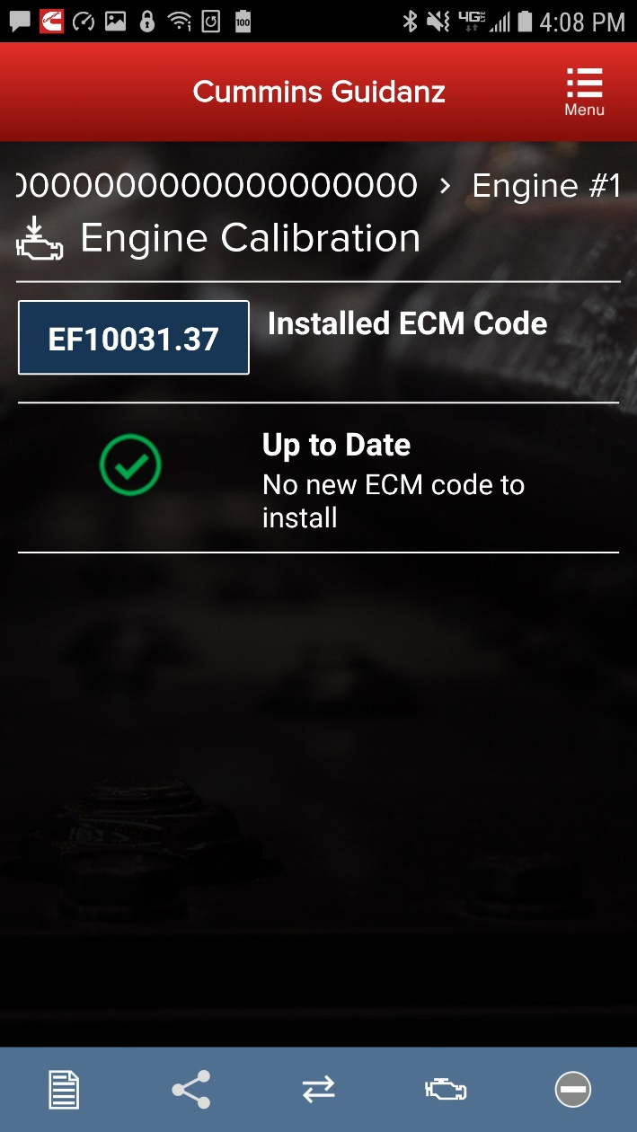
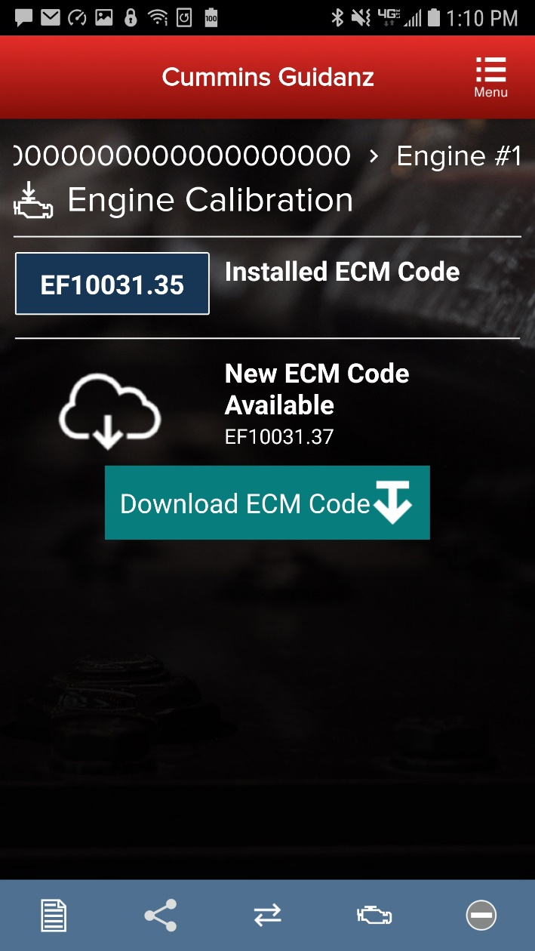
ECM Code Information
If user clicks on Begin Process, after retrieving the calibration data for the connected ECM, the app will display the installed ECM Code and the ECM Code revision.
If the installed ECM Code is already at the latest revision, the user will receive an Up to Date notification that there is no new ECM code to install.
If there is a newer ECM Code revision, the app will prompt the user to Download ECM Code.
Once the user clicks on Download ECM Code the app will validate the revision compatibility and then download the new ECM Code.
Public

Slide 40
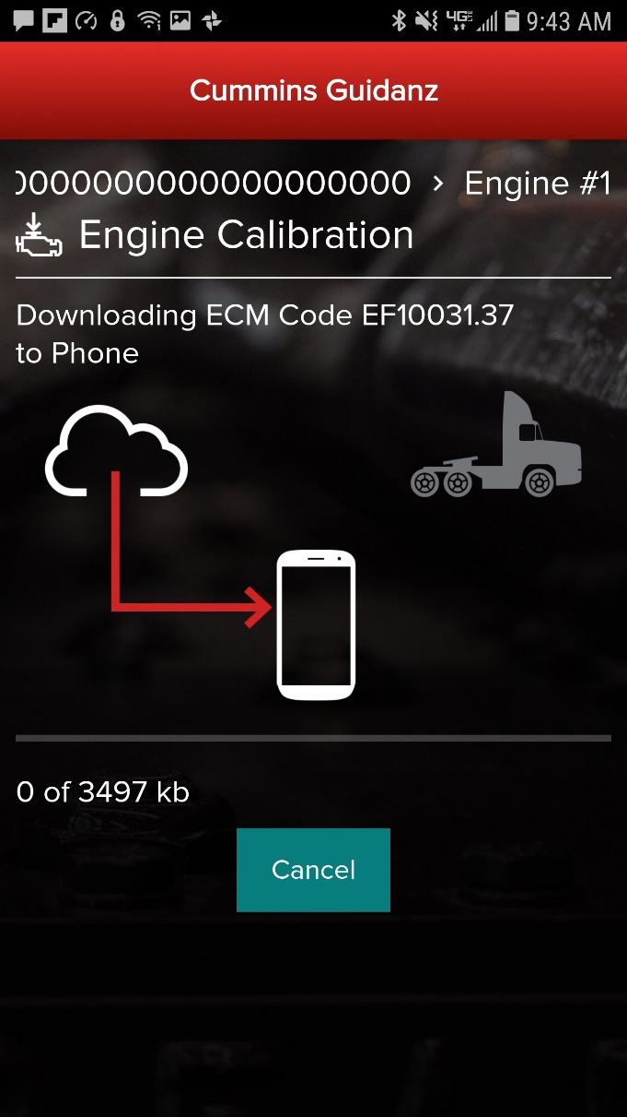
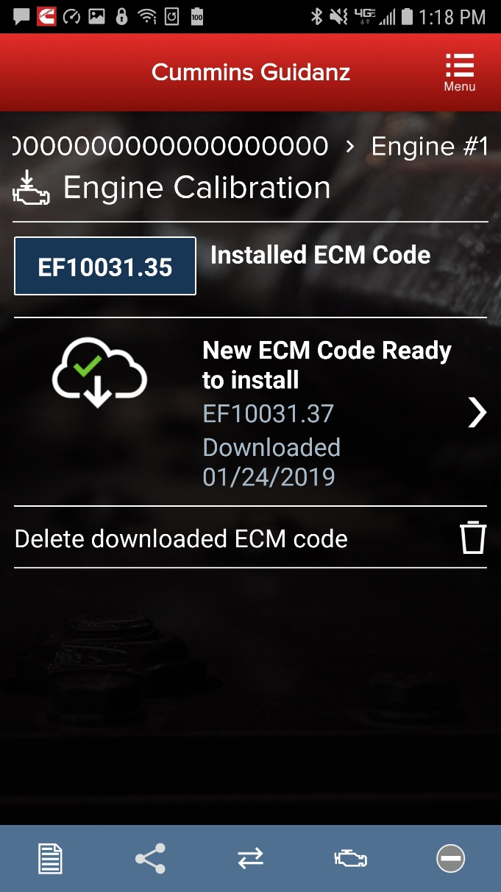
ECM Code Information
After the app has downloaded the latest ECM Code revision from the cloud, or if the ECM Code has already been downloaded and stored on the phone, a message will be displayed that a new ECM Code is ready to install.
The user can also delete the downloaded ECM code at this point.
Public

Slide 41
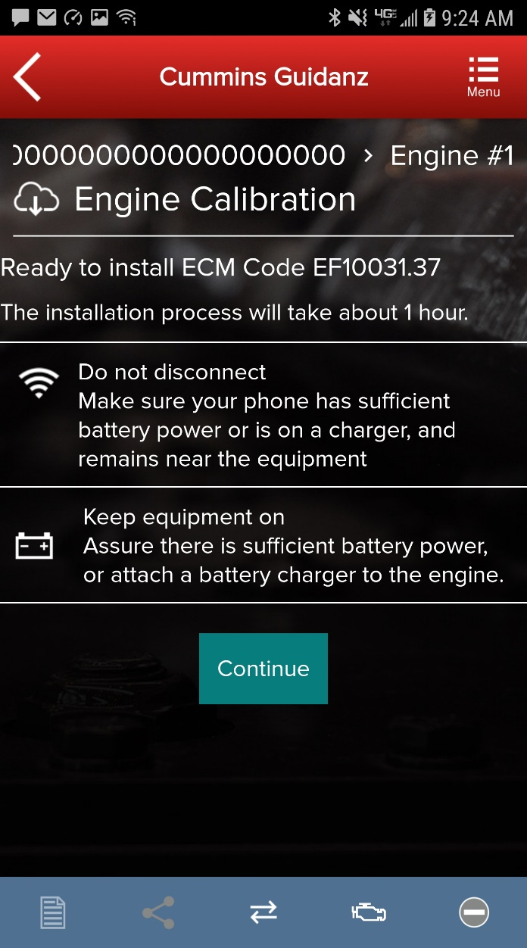
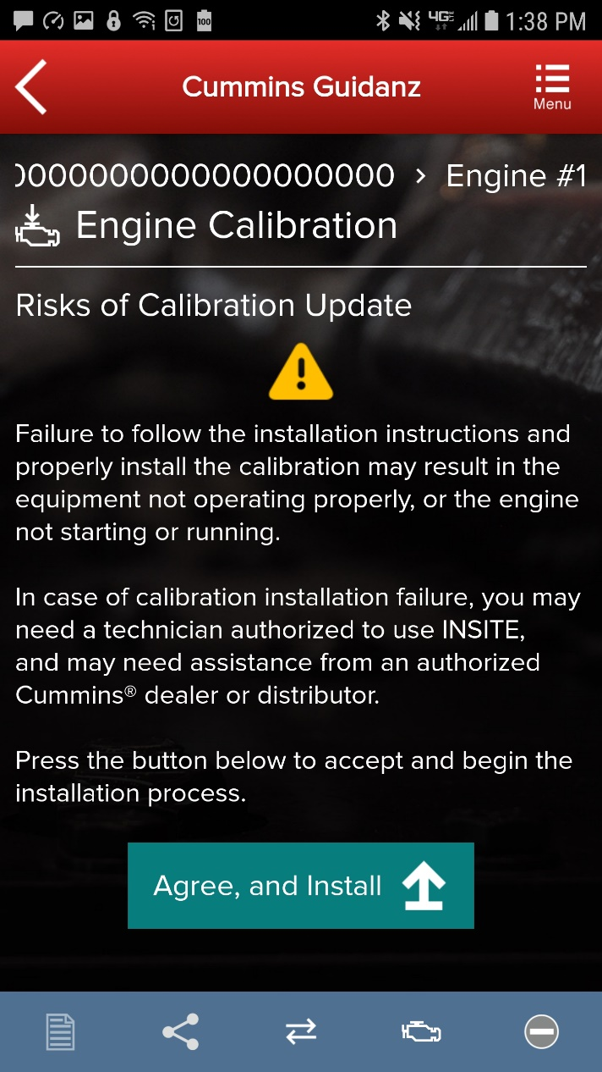
User Warning Messages
When the user clicks New ECM Code Ready to Install, the app will display warning messages. The user must read and click Agree, and Install to start the installation process
If the user has to enter a master password to unlock the device, the Risks of Calibration Update warning message will be displayed twice.
Public

Slide 42
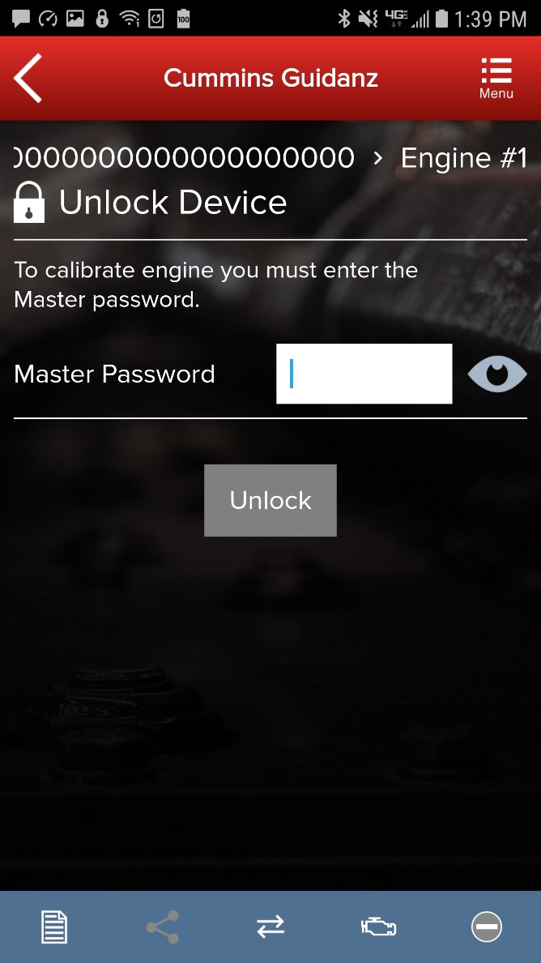
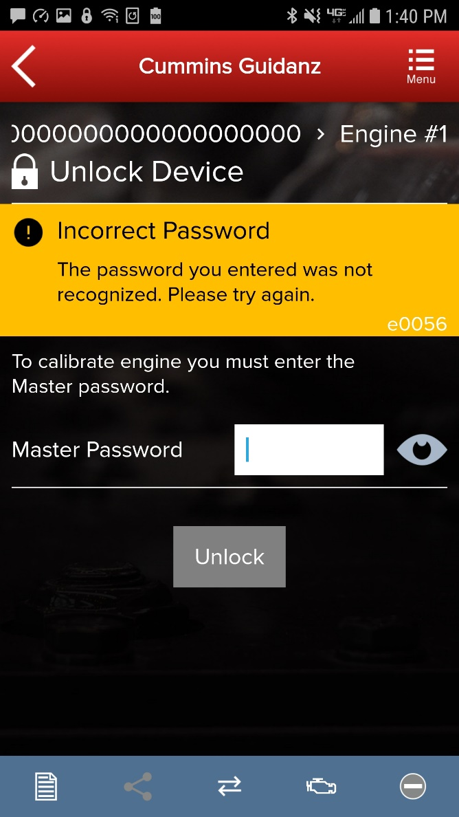
Multi-Level Security
If master password is set, user will be prompted for password.
Public

Slide 43
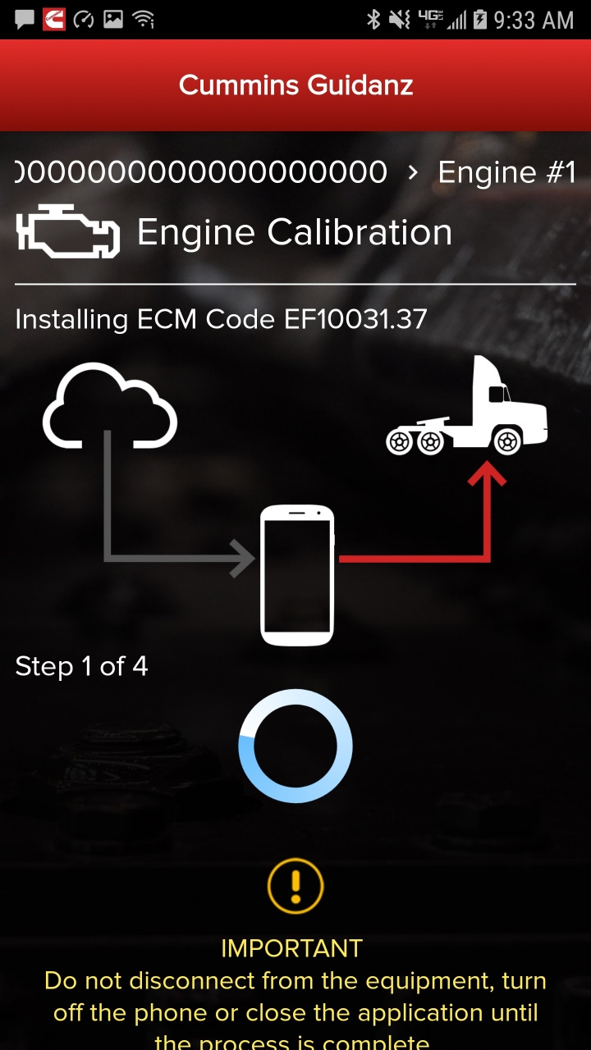
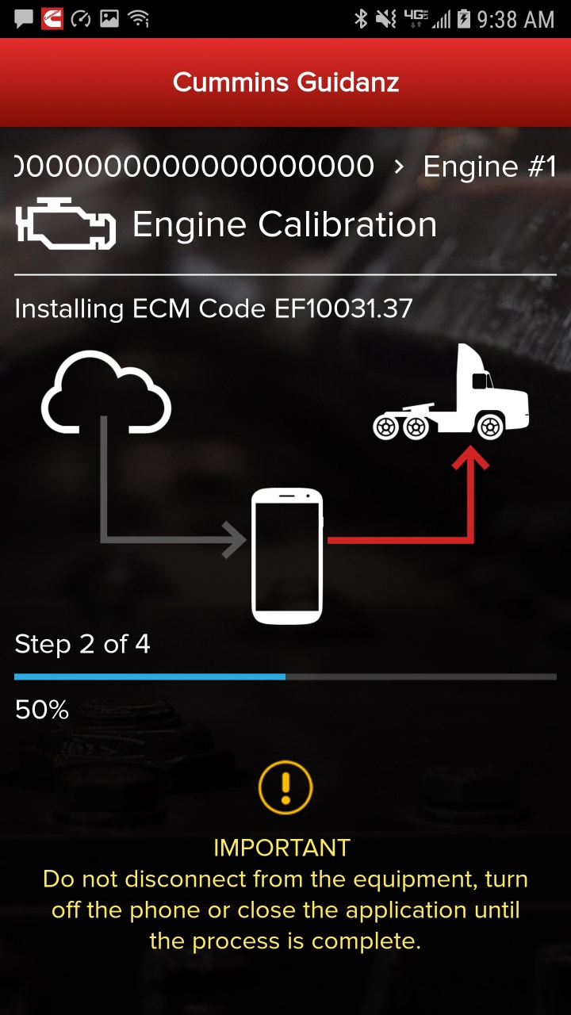
Calibration Installation Process
The app will go through Steps 1 - 4 of the installation process.
Public

Slide 44
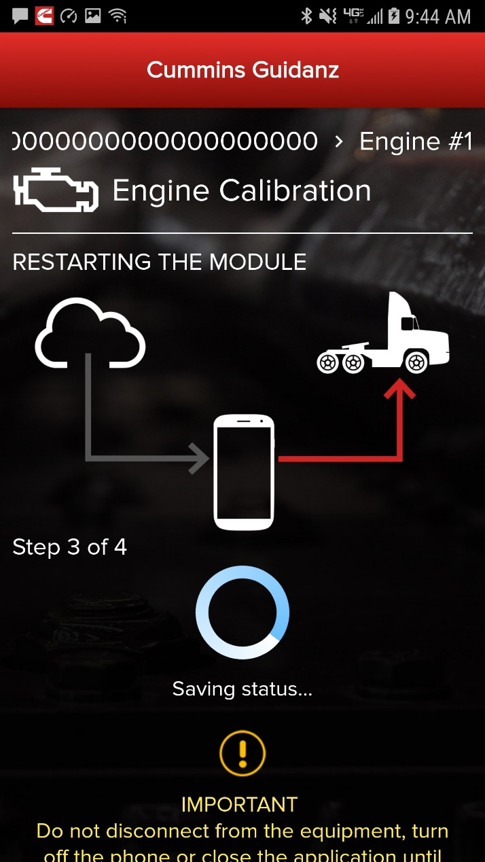
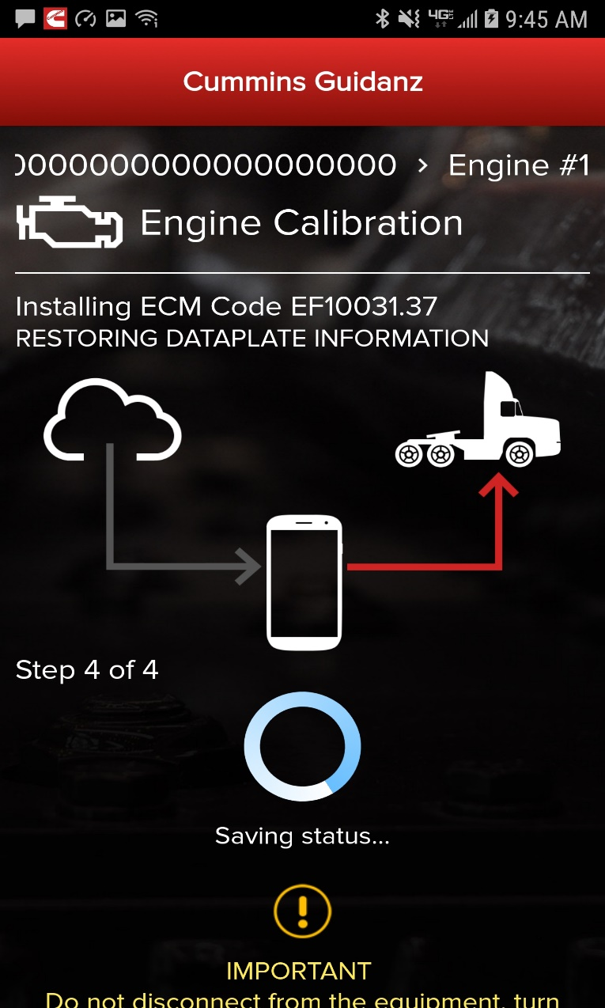
Calibration Installation Process
The app will go through Steps 1 - 4 of the installation process.
Public

Slide 45
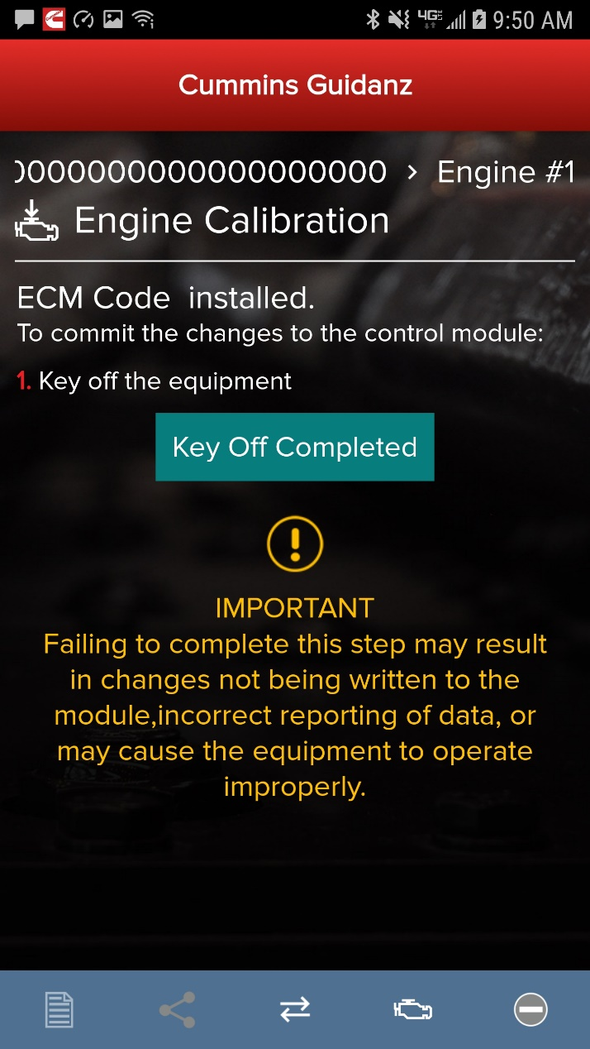
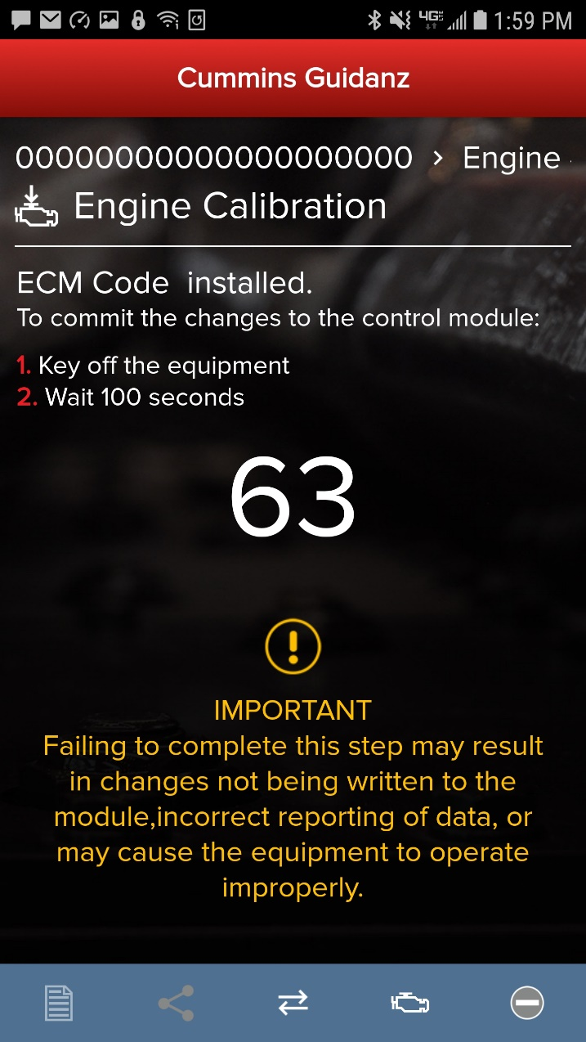
Key Off Instructions
After completion of the 4 installation steps, the user is prompted to key off. A timer will count down. Its length is determined by the engine type.
Public

Slide 46
Key On Instructions
After the timer reaches 0, the user is prompted to key back on, at which time the app is reconnecting to the ECM.
Public

Slide 47
Calibration Installation Success
The app will inform the user whether the installation was successful.
Public

Slide 48
Calibration Recovery Process
Prerequisites:
Calibration Recovery only works for ESNs that are in no parts campaign(s).
Calibration Recovery only works when using the same device that was used for original calibration download.
No fleet counts are required for Calibration Recovery.
Public

Slide 49
Calibration Recovery Process
If there is a loss of communication in Step 1 of 4 of calibration installation, the app will inform the user that the download failed with the option to Try Again. After re-establishing the connection and clicking on Try Again, the calibration download will start again.
Public

Slide 50
Calibration Recovery Process
Snapshot 1
Snapshot 2
If there is a cal download failure in Step 2 of 4 without any loss of communication, the app will inform of the failure status of the module with the option to Try Again.
If there is a loss of communication in Step 2 of 4, the app will inform the user that the download failed with the option to Start Over (Snapshot 2). After reconnecting, you will see Snapshot 1.
At this point, in both cases, the module is ROM booted.
Public

Slide 51
Calibration Recovery Process
Snapshot 1
Snapshot 2
If there is a cal download failure in Step 3 of 4 or Step 4 of 4 without any loss of communication, the app will inform of the failure status of the module with the option to Ignore and Continue or Try Again.
If there is a loss of communication in Step 3 of 4 or Step 4 of 4, the app will inform the user that the installation failed with the option to Start Over (Snapshot 2). After reconnecting, you will see Snapshot 1.
If the cal recovery does not work, the user can chose to Share the Recovery Files and use INSITE to recover.
At this point, in both cases, the module is up-to-date but few parameters failed to restore.
Public

Slide 52
Calibration Recovery Process with INSITE
If any of above prerequisites for calibration recovery process is not met, user has to use INSITE to try to recover a rom-booted ECM.
In Guidanz Mobile app, go to the event folder and find the trim recovery file (ending in .trm). Share the file with a user who has INSITE installed on his computer and the required INSITE subscription.
Save the trim recovery file in the C:\Intelect\INSITE\Cal Logs folder. Connect to the rom-booted ECM and download the same calibration as in the app while using the trim recovery file. A fleetcount will be required.
Public

Slide 53
Analyze Equipment
When selecting Analyze Equipment the app pulls up Engine Serial Number, and Customer Name from ECM, and the user can edit them if they are incorrect. The user can also enter Customer Unit Number and Odometer/Engine hours and Complaint or Other Notes.
The user is taken directly to the Equipment Dashboard
Faults will be displayed in a prioritized order
Does not apply to multiple ECM engines
An event folder will be created. The Event Number is being displayed.

Slide 54
Engine Serial Number (ESN) Eligibility Check
The app will notify the user of the availability of a calibration campaign.
Every time a user connects to an ECM, if a calibration campaign is found a notification of Calibration Campaign Availability will be displayed if the ESN is in campaign.
If user clicks on Begin Process the app will take the user to the Calibration Download process.
If the Engine Serial Number in the ECM is not part of a calibration campaign, there will not be a notification.
If the user wishes to participate in cal campaign field test, please contact CumminsFieldTest@cummins.com.

Slide 55
Equipment Dashboard (Equipment Summary Screen)
The equipment summary screen will show in different sections (if available):
Equipment Dataplate
Cummins Engines
Engine #1
Public Cummins Devices,
Route Parameter Manager
Acumen On-Board Data Logger
Smart Devices, etc.
Other Devices
Transmission
Brake Controller, etc.
A yellow indicator will show unsupported devices (e.g. Rombooted devices)
User can also get to the Equipment Dashboard by selecting Dashboard in the Menu button

Slide 56
Acumen On-Board Data Logger
The ACUMEN On-Board data logger device is supported and allows user detect and display fault and data plate details, and to monitor data.

Slide 57
Equipment Dataplate
Equipment Dataplate can be accessed via the ECM Device Dashboard and Engine Dataplate
It contains the information the user enters such as customer name, manufacturer, model, etc., as well as other information

Slide 58
ECM Fault Screens
Clicking on Faults in the ECM Device Dashboard displays the Faults and Analysis screen
Clicking on an individual Cummins fault code displays the Fault Details

Slide 59
Calibration Files – Viewing calibrations on the device
Selecting “Calibration Files” will allow the user to view calibrations that have been downloaded to the device.

Slide 60
Calibration Files - Search
Selecting “Search Online” will allow the user to enter a base calibration, search for the latest revision.

Slide 61
Calibration Files – Download to device
After searching, users have the option to view the revision history, or download the calibration to their device.

Slide 62
Device Dashboard
Clicking on a device on the equipment dashboard displays the device dashboard
The device dashboard screen shows all the functionality that is available for that device
Core II ECM - Device Dashboard
Currently only “Engine Dataplate” and “Faults” functionality is available
RPM - Device Dashboard

Slide 63
J1939 Device Dashboard and Faults
Clicking on a J1939 device on the equipment dashboard displays the J1939 device dashboard
The device dashboard for J1939 devices allows you to view the faults and fault details.

Slide 64
ECM and J1939 Zero Faults
ECM will display 0 No faults found if no faults are detected.
J1939 devices will display No Faults Detected if no faults can be found.

Slide 65
History and Templates (Event) Folder
Event Folders can be viewed by clicking on History and Templates in the Start screen
Event Folder Details can be viewed by
clicking on an event in the Event Folders screen
clicking on the bottom left icon on the chyron

Slide 66
Device notifications
If the user gets locked out during the calibration download, both the device and the app will inform the user of the calibration installation through background notification.
Public

Slide 67
Immediate Assessment – IAM Subscription

Slide 68
Immediate Assessment
When a truck pulls up to a shop, the service writer pulls up the faults and estimate how long the service will take
Based on the estimated time to service, the truck gets directed to the appropriate service bay
This feature does not apply to multiple ECM engines

Slide 69
Immediate Assessment Service
Old process
The customer is met in the lot by the Service Writer
The SW plugs in a datalink adapter and uses a smart phone app (Fault Advisor App) to get public(SPN/FMI) fault code information from the ECM
QSOL is used to convert the SPN/FMI info into a Cummins fault code
QSOL FCA is used to prioritize the faults
The prioritized faults and engine make/model are plugged into a spreadsheet that predicted the Average Repair Time and Root Causes by percentage
With the Guidanz App, this process can be done within a few minutes. In addition, a Guidanz web (CSS) job can be created using Immediate Assessment Results to reduce intake on Guidanz web.

Slide 70
Home Page
Subscribed User Functionality
Prioritized Cummins fault codes, descriptions, and the top three most likely root causes
Estimated service times
Ability to update Guidanz Web Appointments
Enter ESN and customer information
Select manufacturer and model
Equipment and device data plate information
Create, View, Resume, Delete Events
RPM module support
Create a Guidanz Web Job
J1939 Device Fault
Campaign Calibration installation capability
"Scan Fault" which is a focused function that can be used to just read the faults from the engine without any fault prioritization.
The ability to share any information in the app via email
French, Spanish, Simplified Chinese language support

Slide 71
Immediate Assessment Input
When clicking on New Assessment, user connects the adapter to the truck and pairs to the adapter via the app
The app pulls up Engine Serial Number, and Customer Name from ECM, and the user can edit them if they are incorrect
Based on the confirmed ESN, the equipment make and model list is retrieved from the server.
App pre-selects the data received from warranty data on the server and from the ECM if available, but the user has to make a selection.
If there is no manufacturer list, it can be caused by:
No data based on the ESN provided
No Internet
Server issue

Slide 72
Immediate Assessment Input (continued)
If the user selects ‘Other Manufacturer’, the app prompts the user for the accessibility code
The results are more accurate with manufacturer and model than with accessibility code

Slide 73
Engine Serial Number (ESN) Eligibility Check
The app will notify the user of the availability of a calibration campaign.
Every time a user connects to an ECM, if a calibration campaign is found a notification of Calibration Campaign Availability will be displayed if the ESN is in campaign.
If user clicks on Continue, the app will take the user to the Equipment Dashboard.
If the Engine Serial Number in the ECM is not part of a calibration campaign, there will not be a notification.

Slide 74
ECM Fault Screens - Severity
The app displays the severity to show the current condition of the engine based on below color codes:

Slide 75
ECM Fault Screens – Fast Track Repair Notification
Only if an engine has a fault code which is part of Fast Track Repair (formerly known as Analytic Based Repair), user will be notified that there is a Fast Track Repair available for the associated fault code. User will see the associated solution(s).

Slide 76
ECM Fault Screens – Optimized Diagnostics ( formerly ADBR)
During the initial IA connection, Guidanz will capture Optimized Diagnostics from the ECM.
Please stay connected to the ECM until the ECM data is successfully extracted for the most accurate estimates.
This will take 5 minutes.

Slide 77
Immediate Assessment Output
The faults screen displays the following for each prioritized fault
Typical Service Times for fault (if available)
Top Likely Root Causes

Slide 78
Immediate Assessment Output (Continued)
Not all faults will have estimated service time based on manufacturer and model
If estimated service time is not available, the user can select to enter accessibility code
If data is available based on accessibility code, the app will display estimated service time for the faults that didn’t have data before. (It is possible that even with the accessibility code, some faults still may not have estimated service times)
If there are no faults detected, 0 Faults will be displayed.

Slide 79
Creating Guidanz Web job from Faults and Analysis Screen
When immediate assessment has been performed, the user works for a Guidanz Web location, and there is an Internet connection, the bottom left icon on the chyron will allow the user to Create a Guidanz Job Order.
Selecting Create Guidanz Job Order will initiate the job creation process.
The Guidanz Job Order number, the Event Folder number as well as the Immediate Assessment number are shown
The user can also Make New Immediate Assessment or View Event Folder Details

Slide 80
Pending Service Requests
User can create an Immediate Assessment from a pending Service Requests.
Pending Service Requests are created in Guidanz Web.

Slide 81
Updating Guidanz Web job from Faults and Analysis Screen
When immediate assessment has been performed from a pending appointment, the user works for a Guidanz Web location, and there is an Internet connection, the bottom left icon on the chyron will allow the user to Update the Job Appointment.
Selecting Update Job Appointment will update the already existing Job Order in Guidanz Web
The Guidanz Job Order number, the Event Folder number as well as the Immediate Assessment number are shown
The user can also Make New Immediate Assessment or View Event Folder Details

Slide 82
History and Templates (Event) Folder
An Immediate Assessment will create an Event Folder. Event Folders can be viewed by clicking on View Events in the Start screen
Event Folder Details can be viewed by
clicking on an event in the Event Folders screen
clicking on the bottom left icon on the chyron

Slide 83
Viewing the Guidanz Web job
To view the Guidanz Web job, go into the respective Event Folder details and click on View Guidanz Job Order Details.
Guidanz web has different links for distributors vs dealers. Clicking on the link will open Guidanz web on a web browser that the user will need to sign into to view the job.
Distributor (Classic): css.cummins.com/cmi
Distributor (Evolution): https://guidanzfsl.cummins.com/cmi
(Chrome is the preferred browser)
Dealer (Classic): css.cummins.com

Slide 84
Engines not supported
Engine Program | ECM |  | Engine Program | ECM
480C-E | CM552 |  | ISM | CM570
B5.9G | CM420 |  | ISM - CM870 | CM870
C Gas Plus/B Gas Plus | CM556 |  | ISM - CM875 | CM875
C8.3G | CM420 |  | ISM - Fuel Control Module - CM570 | CM570
CELECT | ECM-B |  | KTA19, G855 CM558 G Drive | CM558
CELECT Plus | ECM-C |  | L Gas Plus | CM556
CELECT Plus Industrial | ECM-C |  | L10G | CM420
Centinel | CM400 |  | PIM | CM550
CENTRY | CM400 |  | QSB5.9/44, 5.9/30, 4.5/30, 3.9/30 | CM550
Gas Compression GTA3.9/5.9/8.3GC, KTA19/38GC - SSM558/CM556/CM2358 | CM556 |  | QSC8.3/QSL9 | CM554
 | SSM558 |  |  | CM500
ISB | CM550 |  | QSK19/23/45/60/78 | CM500
ISB - CM850 | CM850 |  | QSK19G/38G/60G, QSV81/91 - CM700/SSM558/CM2358 | CM700, SSM558
ISB Daimler Chrysler | CM551 |  |  | CM2358
ISBe (4 and 6 Cylinder) | CM800 |  | QSM11 | CM570
ISBe2/3 - CM850 | CM850 |  | QST30 | CM552
ISBe4 (4 and 6 cylinder) | CM850 |  | QST30 - Power Gen | CM552
ISC / Transit Bus ISL8.3 - CM850 | CM850 |  | QSX15 | CM570
ISC/ISL | CM554 |  | Signature/ISX | CM570
ISL8.9 - CM850 | CM850 |  | Signature/ISX - CM870 | CM870
ISLe4 (6 cylinder) | CM850

Slide 85
Questions or Issues
Please contact Cummins Care for any questions or issues
Call: 1-800-CUMMINS
Email: ServiceToolSupport@cummins.com
Chat Service: www.cummins.com
Tool Support Website: www.cummins.com
Public

