Slide 1
Cummins Guidanz™ Mobile Service Feature Training
Public

Slide 2
Table of Contents
General app information
New Release Information
Hardware Requirements
Download/Installation
Supported Adapters
General Usage
Service Features
Questions or Issues

Slide 3
Cummins Guidanz
Guidanz™ is Cummins' new suite of genuine service products, features and capabilities. https://cumminsengines.com/guidanz
Guidanz mobile app includes INSITE like capability and combines everything from diagnostics, training, repair, warranty, metrics and performance feedback
Guidanz app is available for download in US, Canada, Australia, EU (including UK), Mexico, Peru, Columbia, India, and China

Slide 4
Version 5.2.0 Release
What's new:
New features
Calibration import over email
Immediate Assessment for Multi-ECM products
CARB – messages added to ECM Images
Diagnostic Tests:
No New Diagnostic Tests
Advanced Features:
Aftertreatment Maintenance
Fuel Injector Reset
Fuel System Performance Monitor
Maintenance Monitor
Real Time Clock
Engine Abuse History
Idle Shutdown Override
All Features dependent upon the subscriber's user level, and availability in the connected engine
Public

Slide 5
Hardware Requirements
IOS
Bluetooth compatible devices only
iPhone 8, iPad (8th generation), and newer
Minimum space requirements: 1 GB
Recommended space requirements: 2 GB
Android
Minimum OS: Android 7.1 or higher
Bluetooth compatible devices only
Minimum RAM: 2 GB
CPU Architecture: ARMv8-A
64-bit OS and processor only
Minimum space requirements: 1 GB
Recommended space requirements: 2 GB
Public

Slide 6
Download/Installation
Free Download
Android
Search for “Cummins Guidanz” on Google Play
iOS
Search for “Cummins Guidanz” on the App Store
Public

Slide 7
Supported Adapters
INLINE 7
Has Wired/Wi-Fi/Bluetooth capability
Guidanz limited to Bluetooth mode
Works with INSITE as well
INLINE Mini
Bluetooth
More information about Adapters
https://www.cummins.com/parts-and-service/digital-products-and-services/inline
How to purchase adapters?
For Cummins internal employees (non-Distributor) go to Ariba, use non-catalog items and order the part using part number and enter MDC as the supplier
End users can contact their local Cummins distributor or purchase directly from https://store.cummins.com/
Public

Slide 8
Supported Products
2007 and later Engines
List of unsupported devices is available on the user guide at Here
ADEPT Route Parameter Manager (RPM) Module
For More info
https://www.cummins.com/support/digital-products-and-services-support/adept-support
Note: Currently you do not need a subscription to service the RPM module.

Slide 9
General Functionality

Slide 10
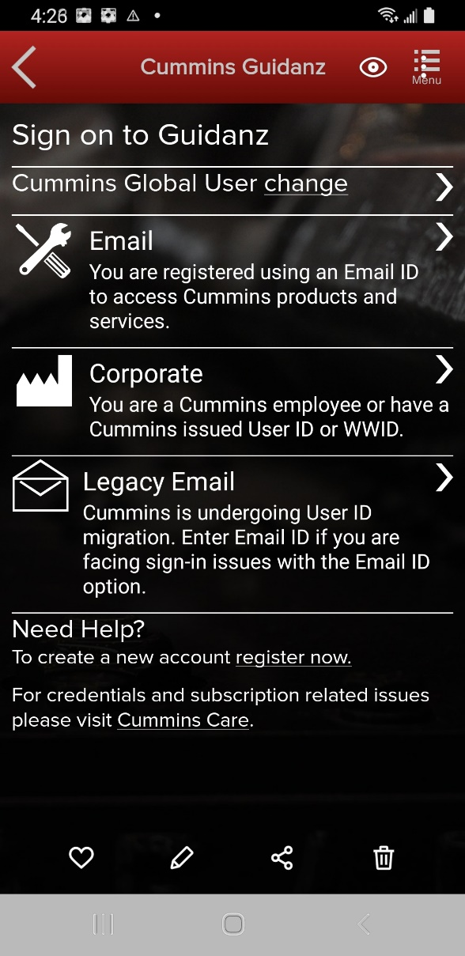
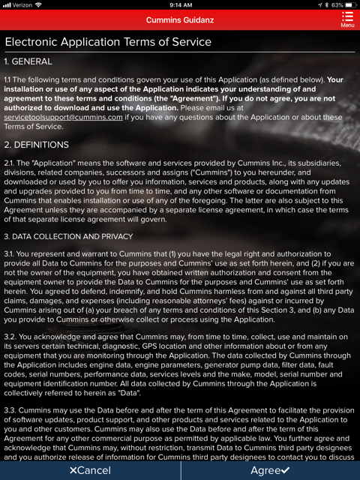
Log-In Screen
All users need to have a valid Cummins user name and password. If not, users can click on the “register now” link or they can register at https://mylogin.cummins.com/web/IAM_NewRegistration?appid=a1a4N00000F2oKa
Email login for user name in Email format
Corporate login for users with a WWID
Legacy Email login for which Email login does not work
After successful Login users will need to set a PIN code and accept the EULA Terms and Conditions to land on Home page.

Slide 11
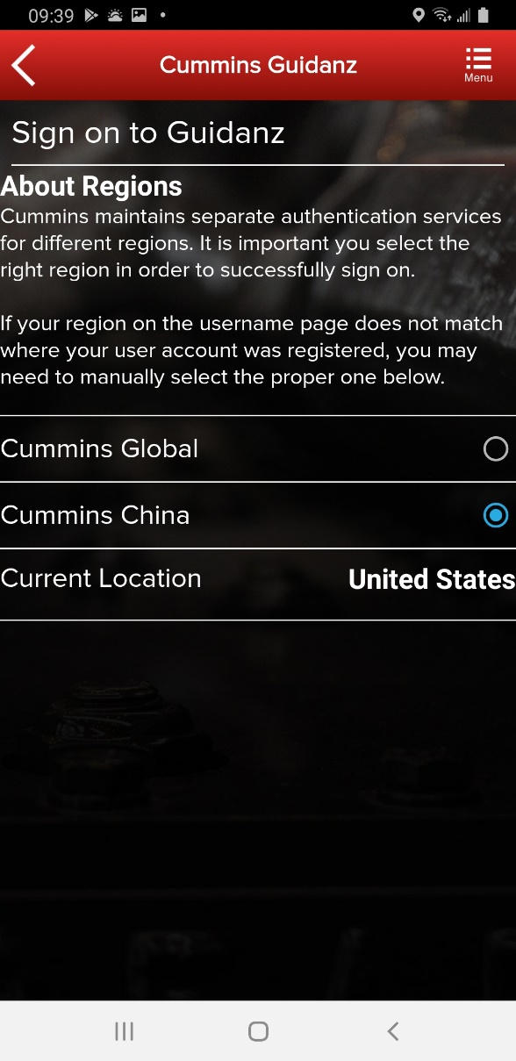
Log-In Screen
If a user registered in China wants to log into the Guidanz Mobile app, the user needs to change the region by clicking on the change link before login for authentication

Slide 12
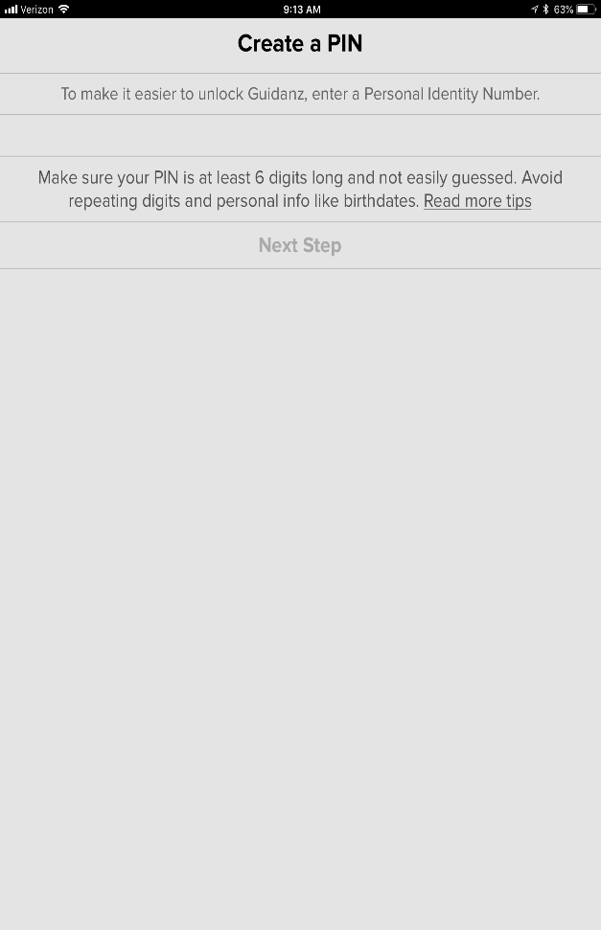
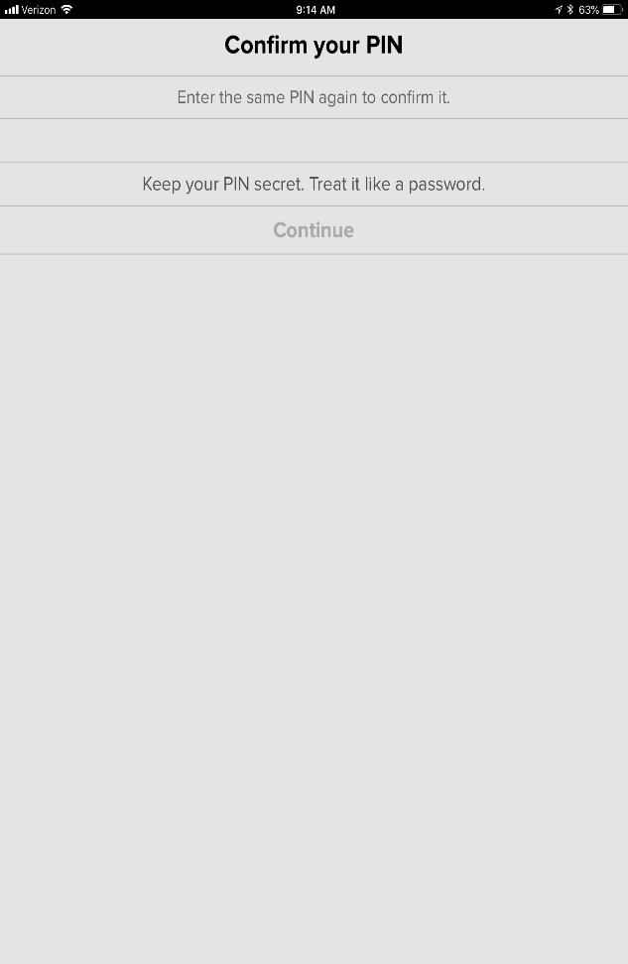
PIN Creation
User is prompted to set a PIN code and then to confirm his/her entry
New PIN security rules
PIN must be at least 6 numbers and can be up to 16 numbers long.
The PIN cannot be an entire sequence of numbers such as 123456 or 654321
The entire PIN cannot be a sequence that simply repeats two digits like 121212
You cannot repeat any single number 4 or more times, such as 000012
Try not to use easily guessed sequences of numbers such as your birthdate, address, or phone number
Public

Slide 13
Subscription Expiration Notification
The app will display a notification of active subscriptions expiring within 14 days and expired subscriptions.
Public

Slide 14
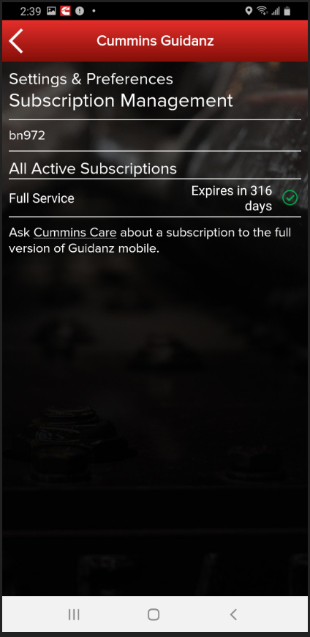
Subscription Management
Subscription Management
The user can see All Active Subscriptions
To access Subscription Management:
Settings & Preferences → Account Management → Select the user under Profiles And Accounts →
Select the User →
Subscription Management
Public

Slide 15
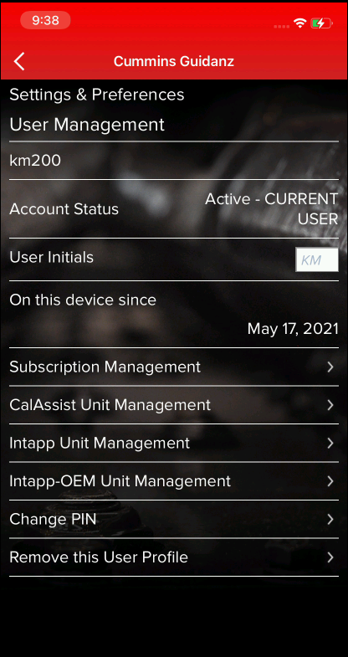
Intapp & Intapp OEM (ECM Password Removal)
Intapp and Intapp OEM units allows users to remove Master, Adjustment, Reset, Anti-theft and OEM passwords.
Both units are purchased through the marketplace.
To view available counts
Go to Settings & Preferences → Account Management → Select the user under Profiles And Accounts → Select the User → Intapp Unit Management or Intapp OEM Unit Management

Slide 16
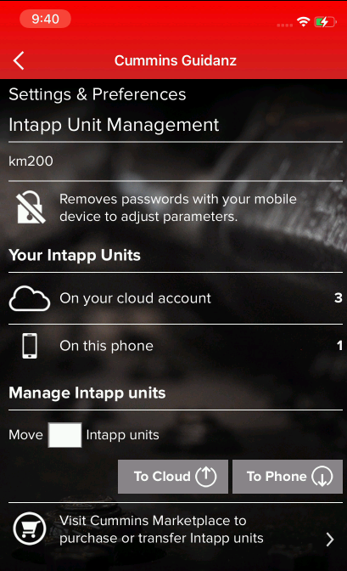
Intapp & Intapp OEM (ECM Password Removal)
Intapp Units and Inatpp OEM Units can be moved between the users online account and their specific devices.

Slide 17
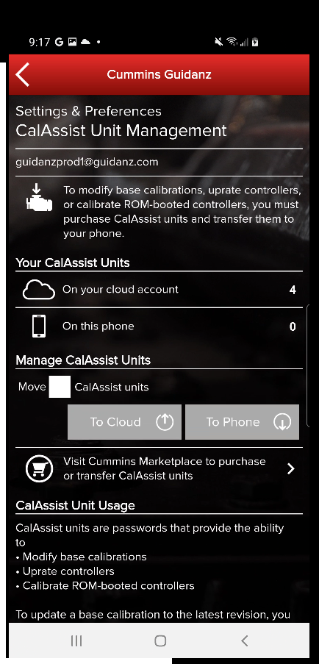
Cal Assist (Fleet Counts)
Changing the Base Calibration requires the use of a “CalAssist Unit”. These counts can be purchased from your distributor or the Cummins Marketplace
To view available counts
Go to Settings & Preferences → Account Management → Select the user under Profiles And Accounts → Select the User → CalAssist Unit Management

Slide 18
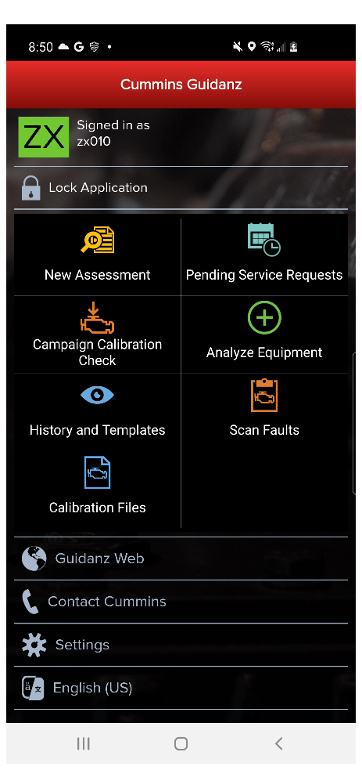
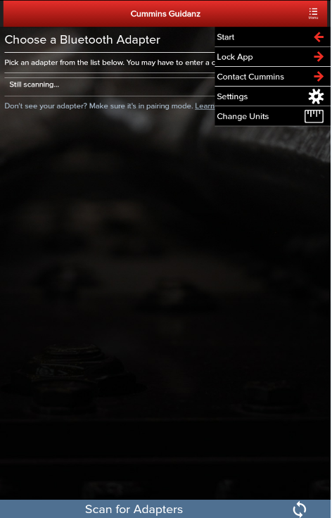
Home Page/Start Page
Another way to get to the Home page is by clicking on Menu → Start while performing any action at which time the Guidanz Mobile app will be disconnected from the ECM.
After logging in, user will see the Home page.
Note: When the user is on the Home Page/Start Page, the Guidanz Mobile app is disconnected from the ECM.
Note: Features displayed on the Home page are dependent upon the user’s subscription level.
Public

Slide 19
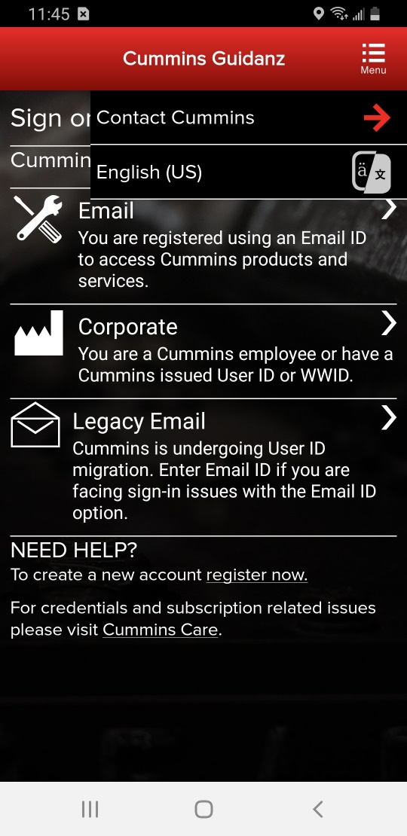
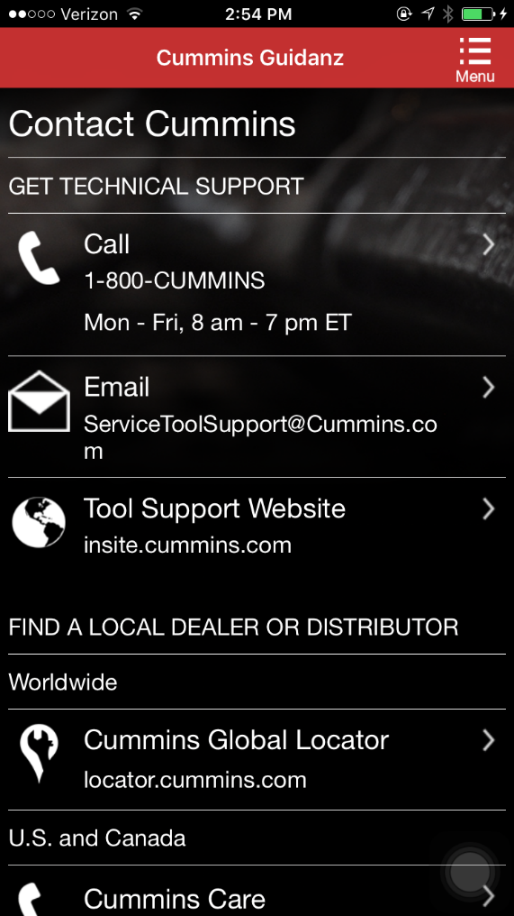
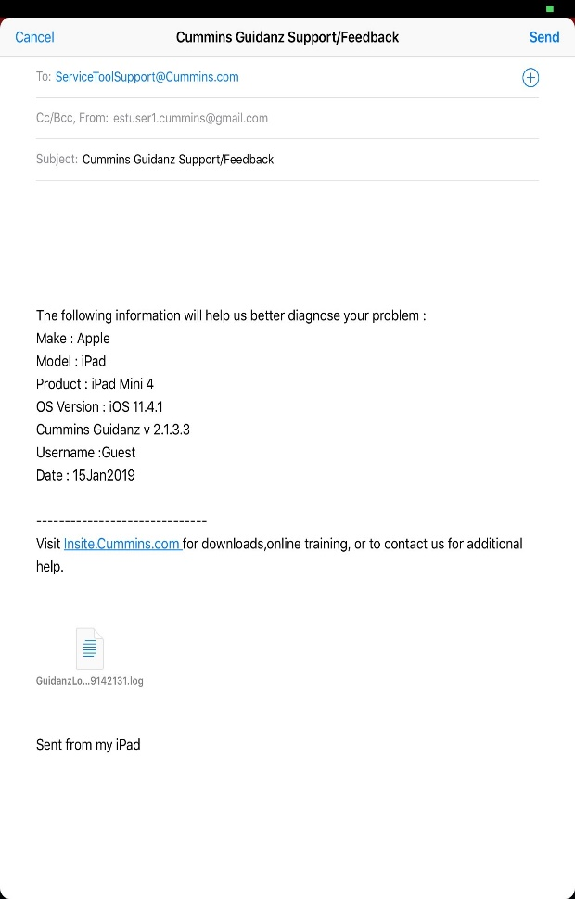
Menu – Contact Cummins/Log File
Allows user to call or email technical support.
On the Start page, click on Contact Cummins.
The email contains device details and attaches a log file that will help the support personnel troubleshoot issues.
Public

Slide 20
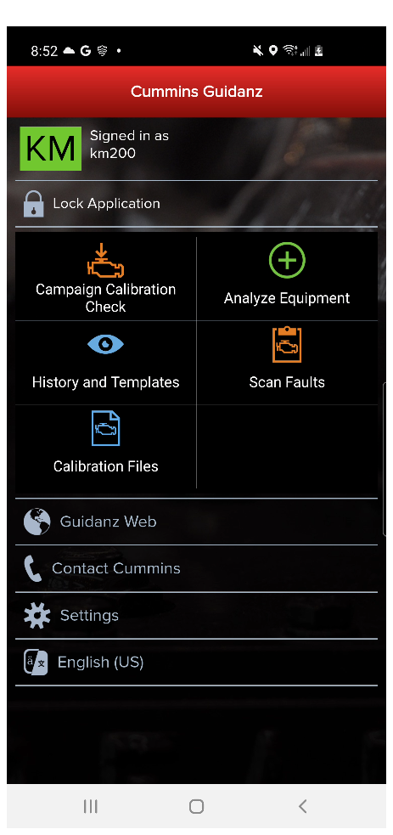
Menu – Contact Cummins/Log File
Or when connected, click on Menu → Contact Cummins → Email
The email contains device details and attaches a log file that will help the support personnel troubleshoot issues.
Public

Slide 21
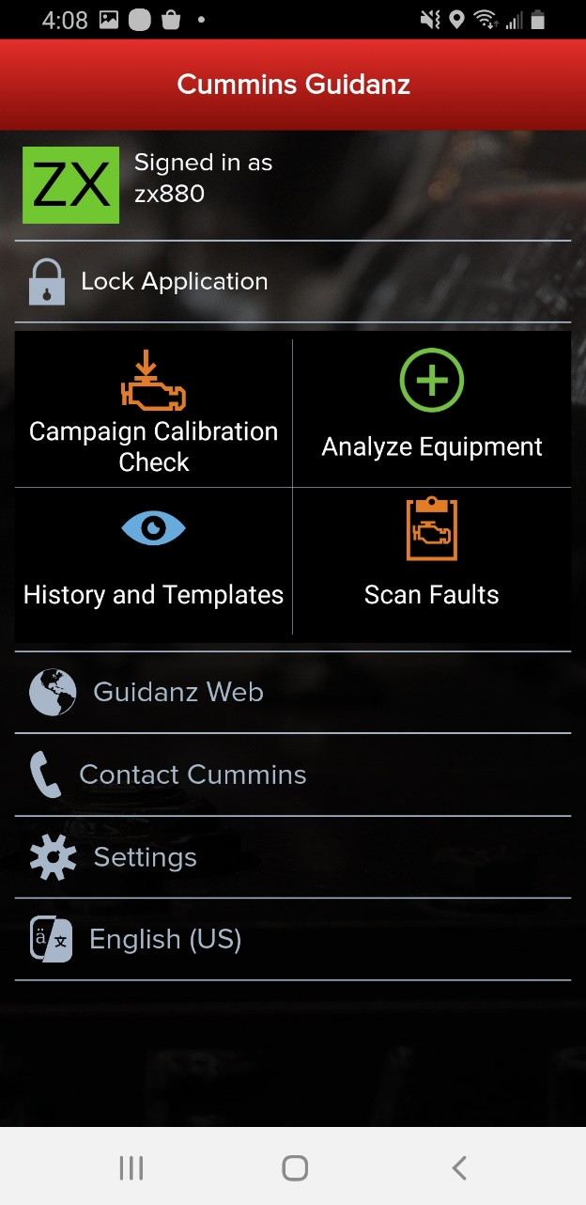
Menu - Settings and Preferences
To access Settings and Preferences:
On the Start page, click on the Settings button
When connected, click on Menu → Settings
Public

Slide 22
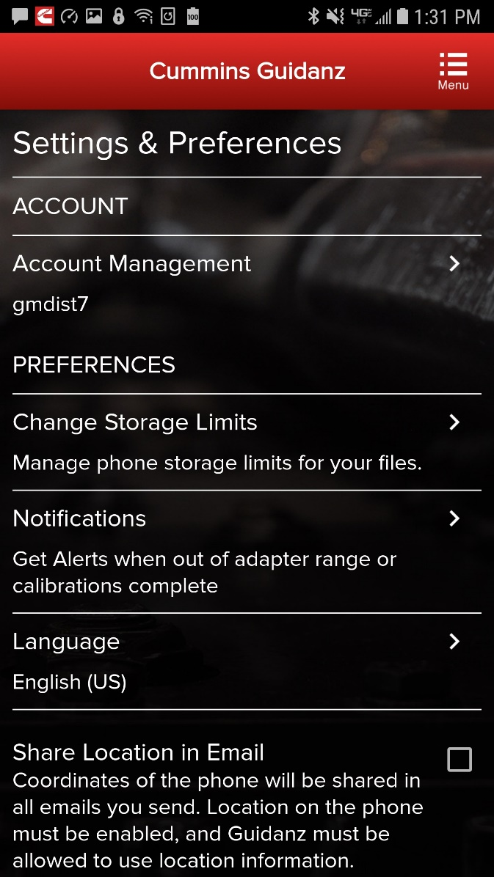
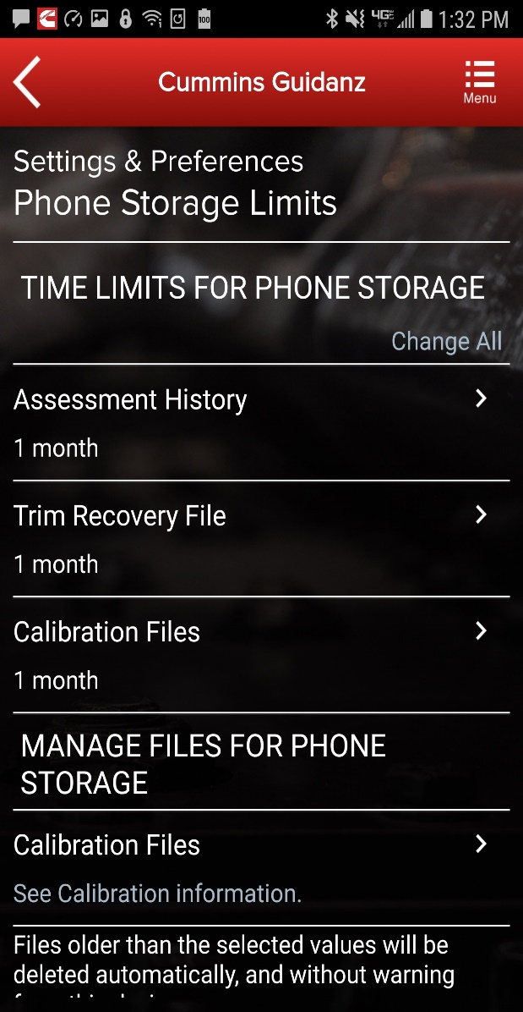
Menu - Settings and Preferences
Change Storage Limits (only for subscribed users)
Allows user to change storage limit for Assessment History, Trim Recovery File, and Calibration Files.
Public

Slide 23
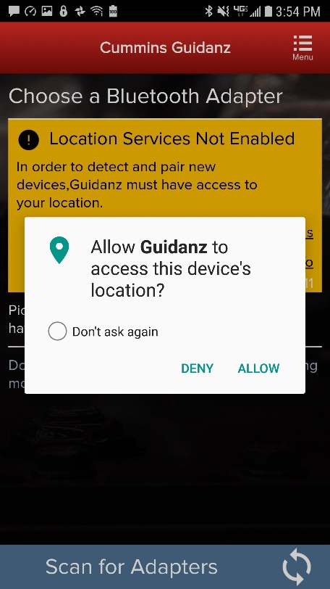
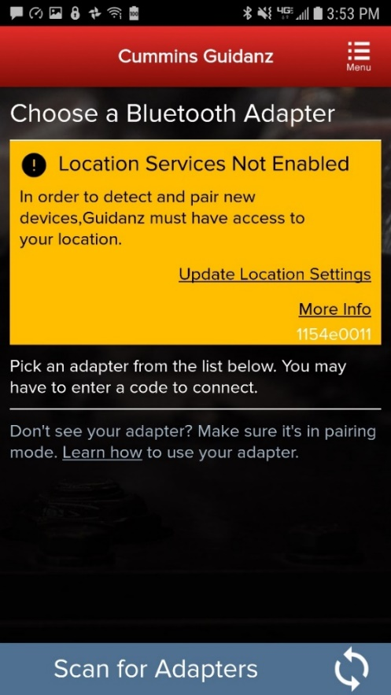
Connecting Adapter to Guidanz
When pairing an adapter for the first time in Android OS Guidanz must be able to access the mobile device’s location.
If device location is not enabled, the user will be prompted to update Location Settings.
Public

Slide 24
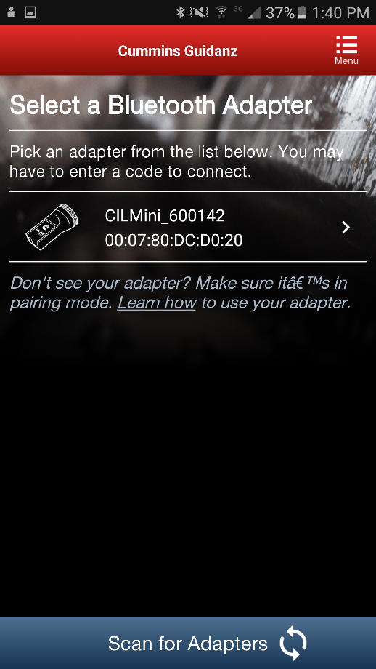
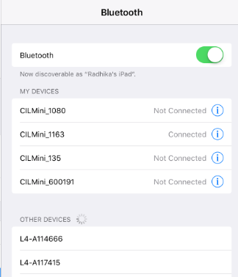
Connecting Adapter to Guidanz
For initial pairing the adapter must be put in pairing mode
Hold the reset button at the end of the adapter for about 2-3 seconds
The light on the adapter will flash for about 2 minutes
You must pair the adapter to the mobile device within that time
Subsequent connections
The mobile device will find the adapter without needing to press the reset button on the adapter
For Android, the app will display the last connected adapter first and then search for the remaining adapters
The adapter can be identified by the last few digits of the serial number on its label
Android
Pairing screen is in the app
IOS
Pairing and connection is done on the mobile device’s Bluetooth settings window
Public

Slide 25
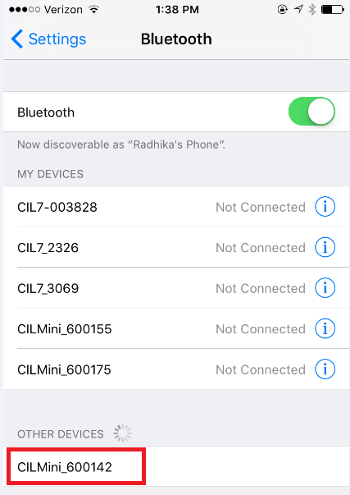
Connecting Adapter to Guidanz
The Guidanz mobile app does not auto connect to the adapter.
Unlike some adapters in the market the INLINE 7 and INLINE mini do not auto connect to the mobile device after the initial connection. This is by design to prevent unintended auto connection in locations where multiple users share the adapters.
Android
Pairing screen is in the app
IOS
Pairing and connection is done on the device’s Bluetooth settings window
Public

Slide 26
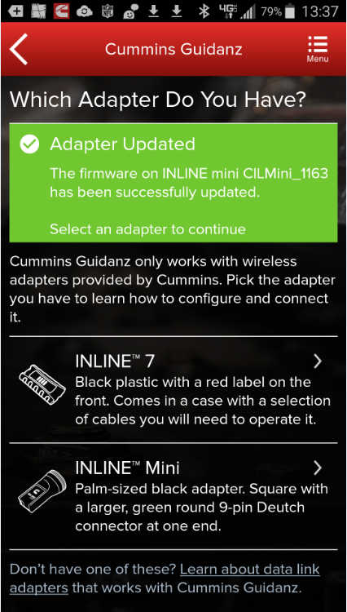
Connecting Adapter to Guidanz
INLINE Mini Firmware Updates
The INLINE Mini is configured to perform automatic firmware updates. When a user connects to an INLINE Mini in Guidanz Mobile if the app detects a necessary firmware update it will be made automatically and the app will display an Adapter Updated status.
The INLINE Mini will need to be reconnected to the Guidanz Mobile app following a firmware update.
Public

Slide 27
Connecting Adapter to Guidanz
Firmware Update of INLINE 7
There are 2 options for updating firmware on an INLINE 7 adapter
Use Cummins Update Manager to update existing INLINE 7 drivers and firmware
Download the latest INLINE 7 drivers and firmware from
https://www.cummins.com/support/digital-products-and-services-support/inline-support
Note: The user will need admin rights to install the INLINE 7 drivers from the website
After installing the new INLINE 7 driver on the PC, the user will need to connect to an ECM using INSITE (or any other electronic software) to upgrade the firmware. The user will be prompted to update the firmware automatically.
Public

Slide 28
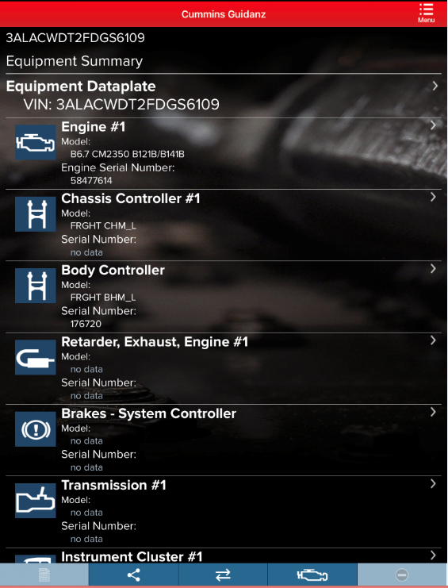
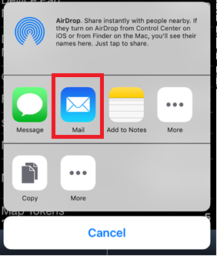
Share Button
User can share the content of the screen via email
Public

Slide 29
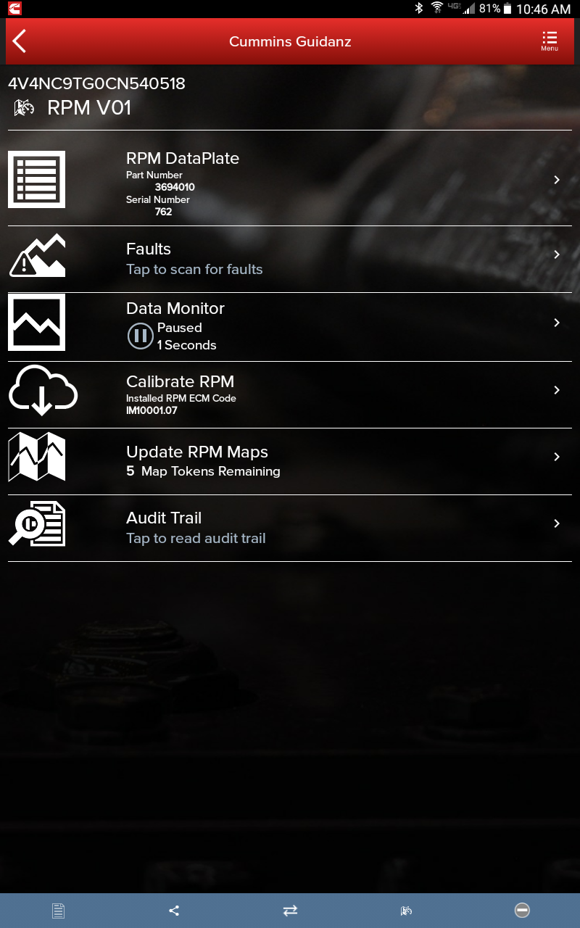
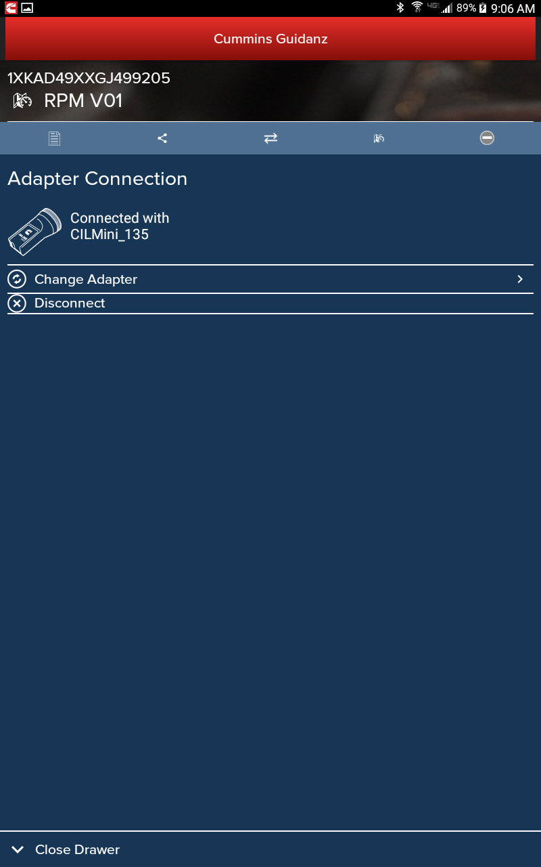
Connection Button
The connection tab in the chyron/footer on each screen brings up a chyron drawer which allows a user to change adapter or disconnect from the adapter
Public

Slide 30
Manual Refresh
No separate refresh button
Users can manually refresh by swiping down the mobile device screen
Public

Slide 31
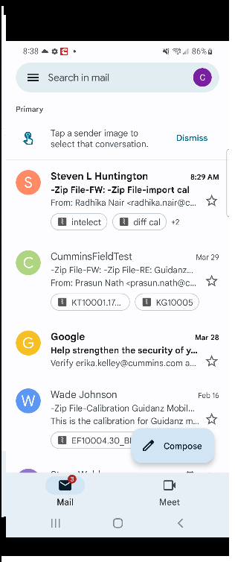
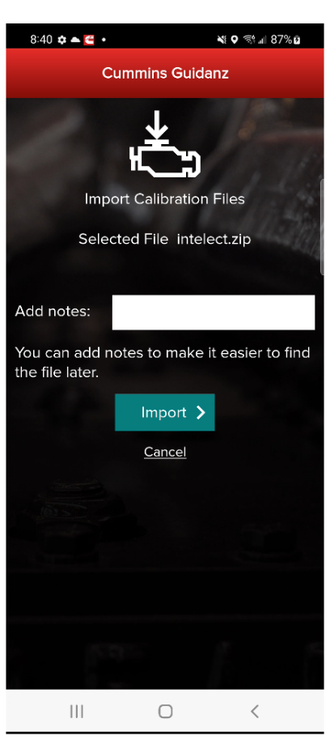
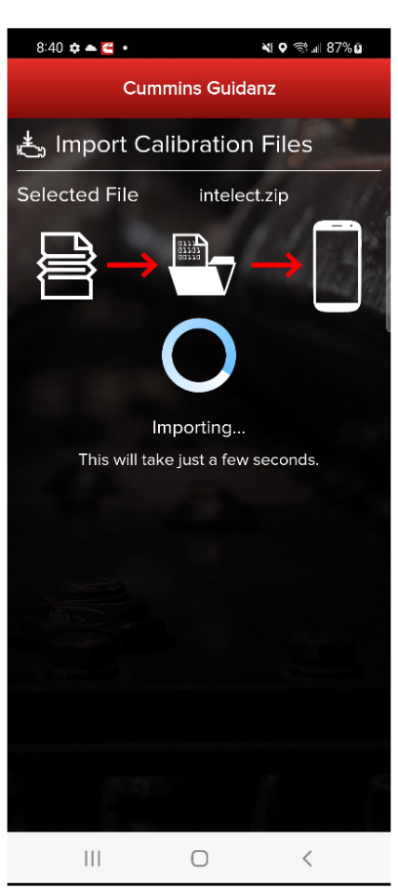
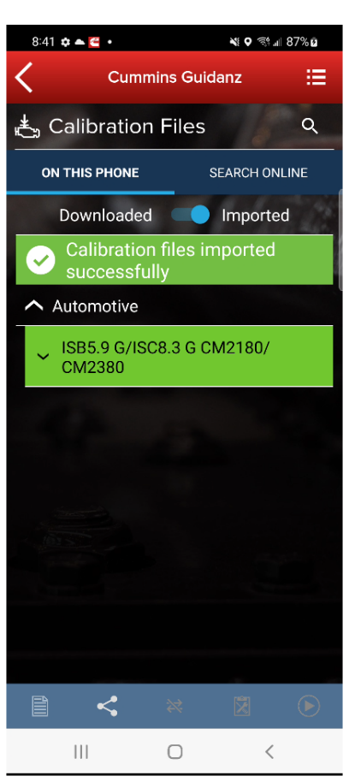
Calibration Import from mail
Compatible calibrations can be imported directly from the mobile device email.
Share the calibration
with Guidanz
to begin the process

Slide 32
Service Features
Public

Slide 33
Home Page
To check for Service functionalities, click on the Analyze Equipment button which will connect the user to the ECM.
Public

Slide 34
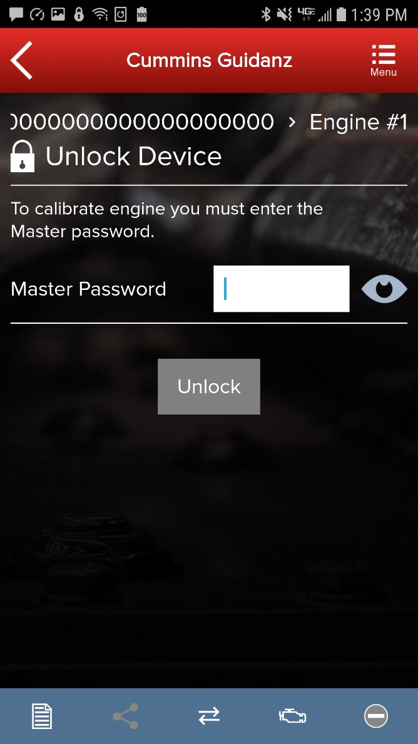
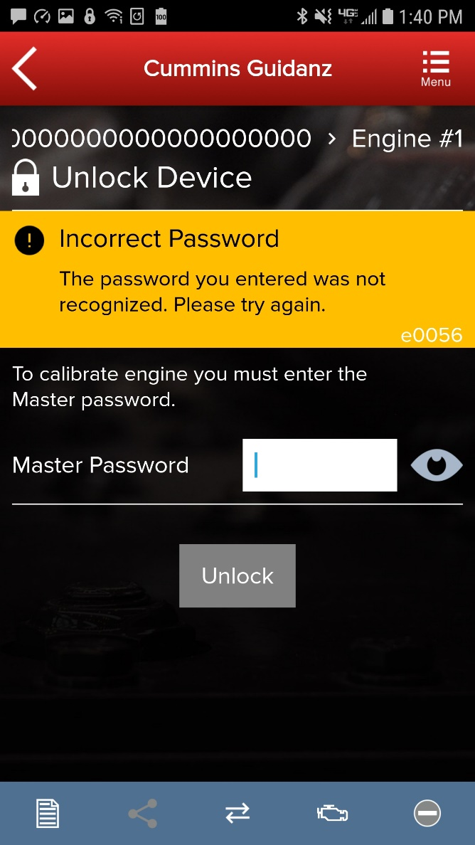
Multi-Level Security
If master password is set, user will be prompted for password.
Public

Slide 35
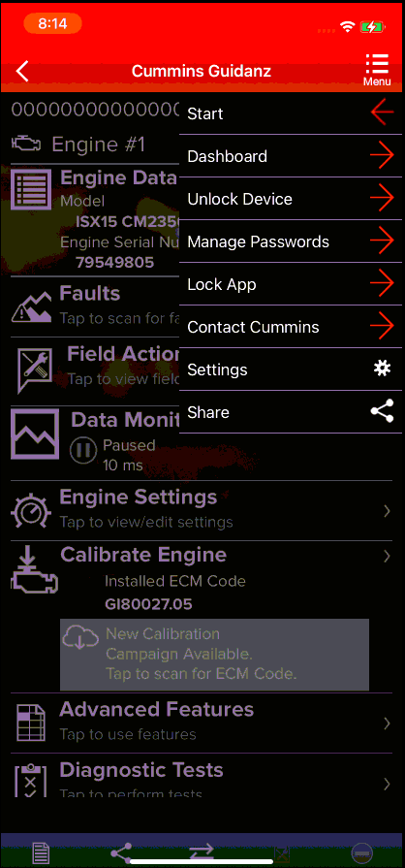
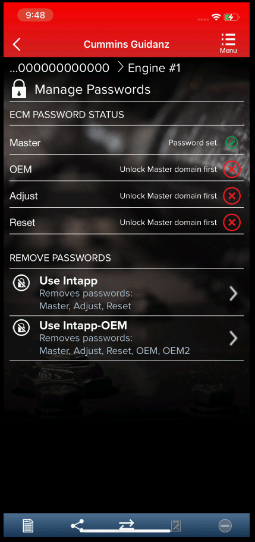
Intapp Password Removal
If Master, Adjustment, Reset, or Anti-Theft password is set, a standard Intapp can be used to remove the password
If the OEM or OEM2 password is set, an Intapp-OEM can be used to remove the password
Click on the top right Menu → go to Manage Passwords or Unlock Device → Select Remove Passwords
Public

Slide 36
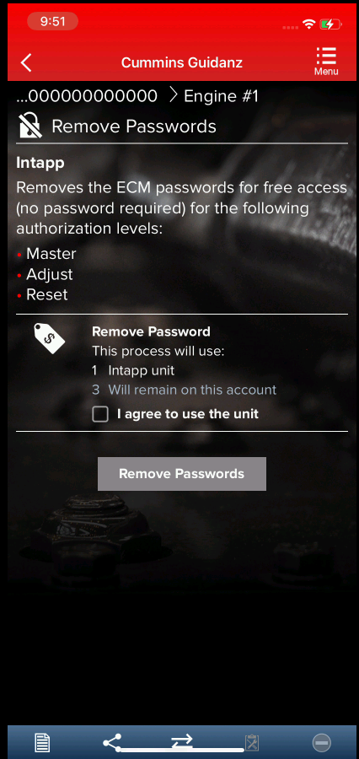
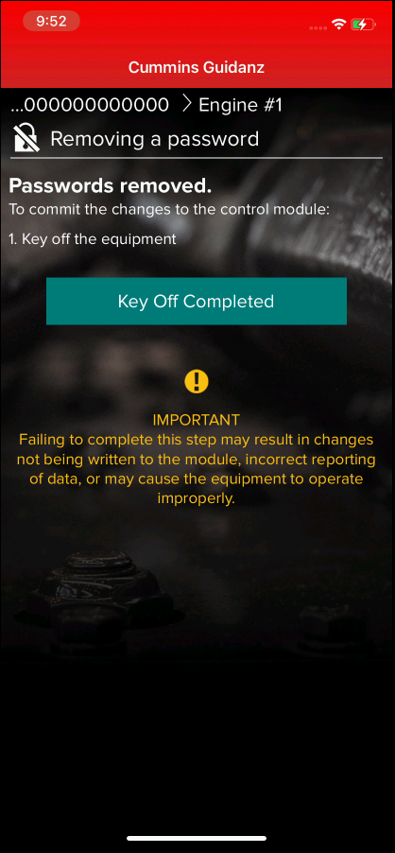
Intapp Password Removal
Select the appropriate type of Intapp required to unlock the password.
Tap the Agreement checkbox and then tap the Remove Passwords button which will take the user through the Key On/Key Off process.
→
Public

Slide 37
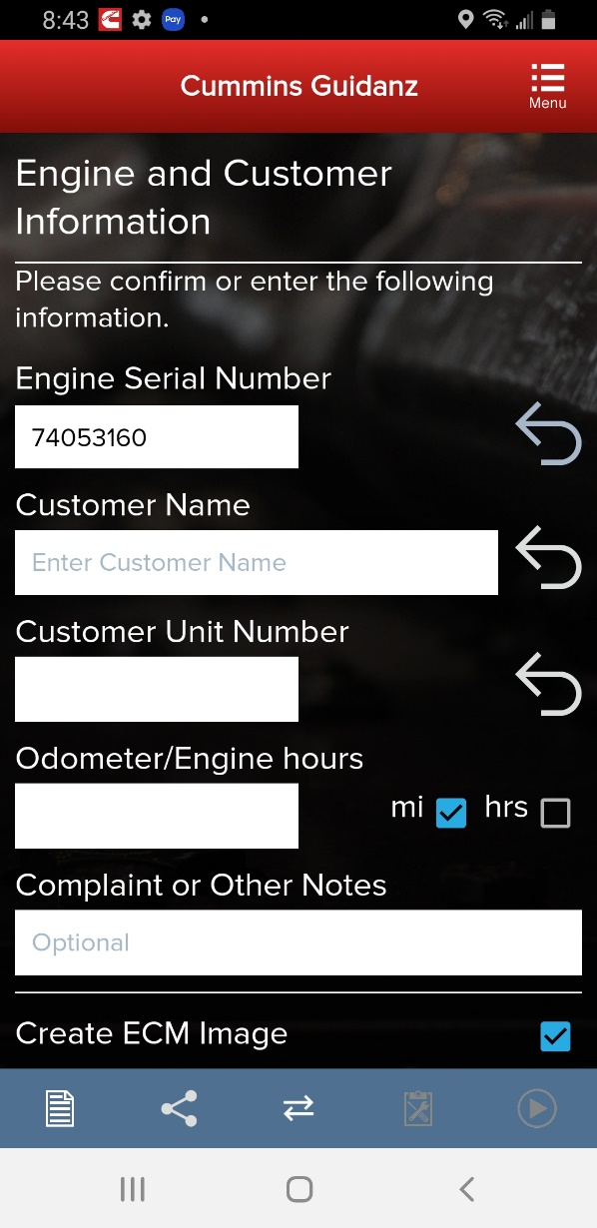
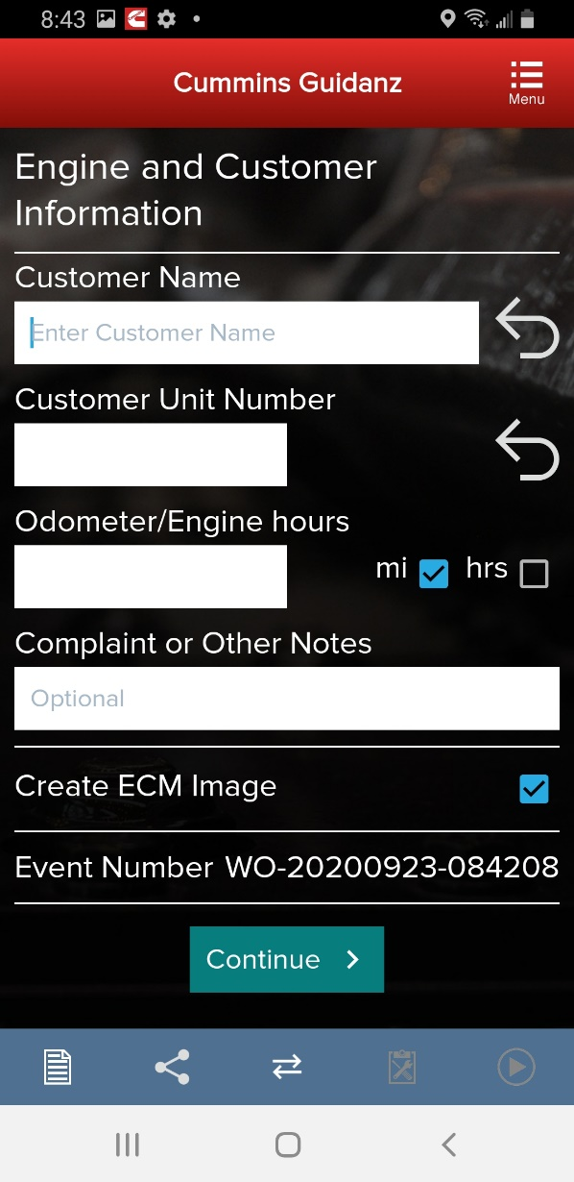
User Input Screens
When clicking on Analyze Equipment, user connects the adapter to the truck and pairs to the adapter via the app
The app pulls up Engine Serial Number, and Customer Name from ECM, and the user can edit them if they are incorrect
The user can also enter the Customer Unit Number, the Odometer or Engine hours, a complaint or other notes.
The Event Number to later retrieve the information in History and Templates is also displayed

Slide 38
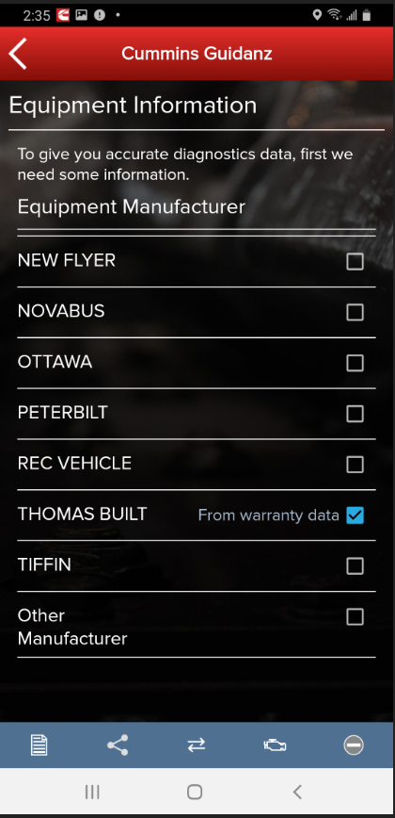
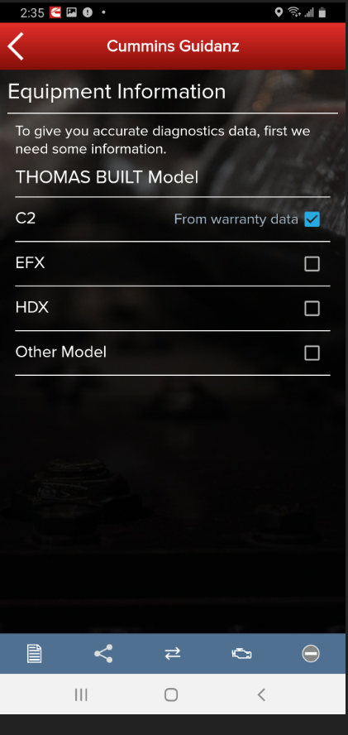
User Input Screens
Based on the confirmed ESN, the equipment make and model list is retrieved from the server.
App pre-selects the data received from warranty data on the server and from the ECM if available, but the user has to make a selection.
If there is no manufacturer list, it can be caused by:
No data based on the ESN provided
No Internet
Server issue

Slide 39
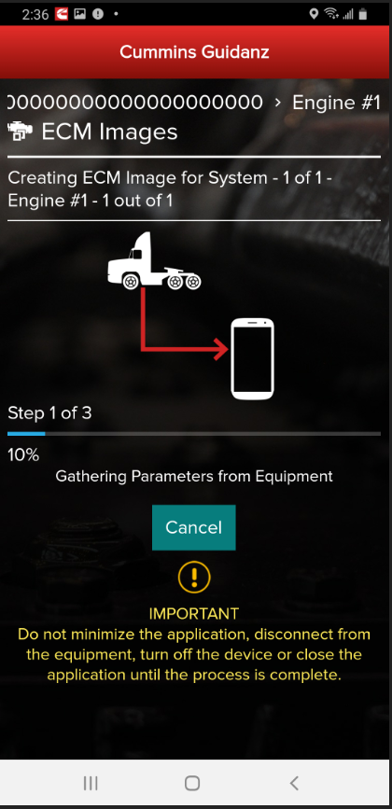
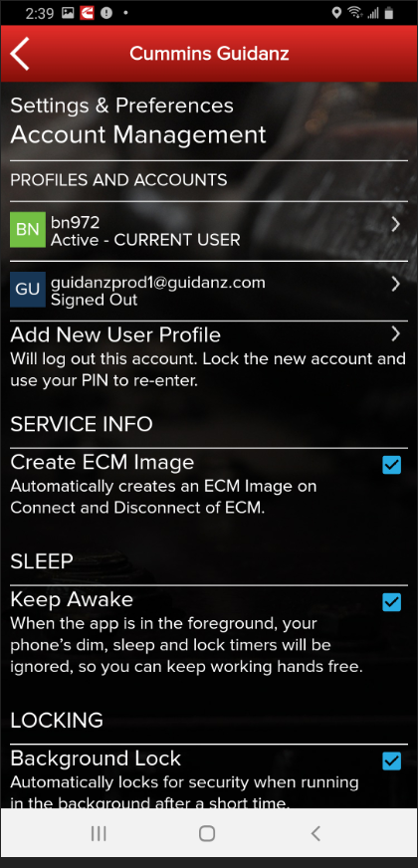
ECM Image Creation
During input, user can also select whether to create an initial ECM image or not by selecting or deselecting the checkbox.
ECM images are created at the beginning and end of a connection to the ECM.
During ECM image creation user can cancel out of ECM image creation by clicking on Cancel button.
ECM image creation can also be enabled or disabled in Settings. Go to Settings & Preferences → Account Management and check or uncheck the Create ECM Image checkbox.
ECM images are saved in the History and Templates folder which can be accessed through the Home screen.

Slide 40
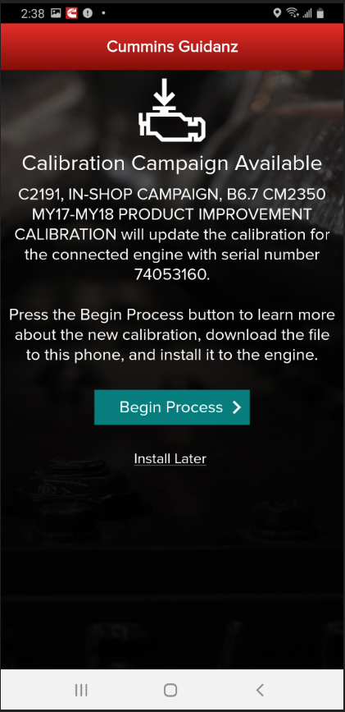
Engine Serial Number (ESN) Eligibility Check
If the ESN entered in User Input screen is eligible for a cal campaign, Guidanz mobile will notify the user of the availability of a calibration campaign calibration.
To get to the Equipment Summary screen, click on Install Later.
Public

Slide 41
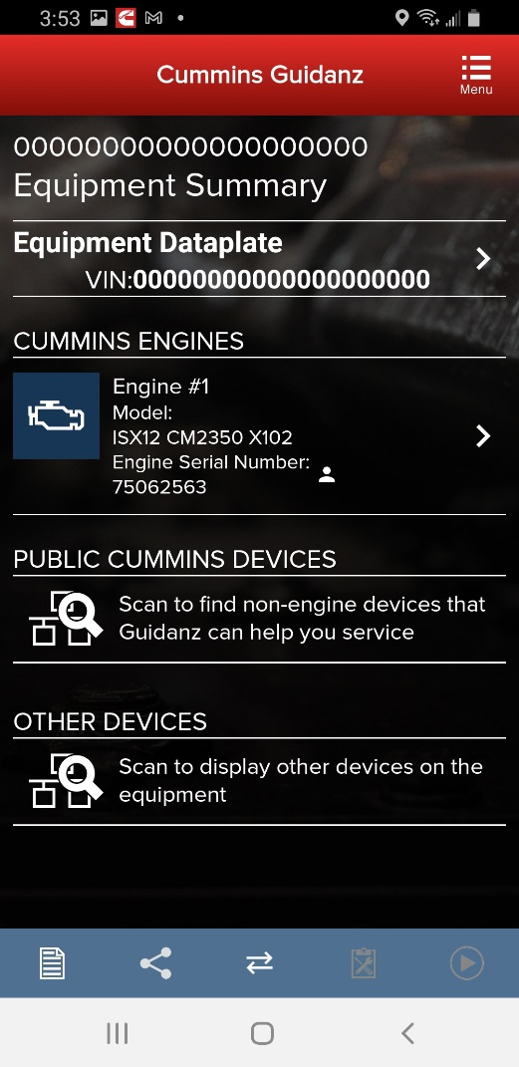
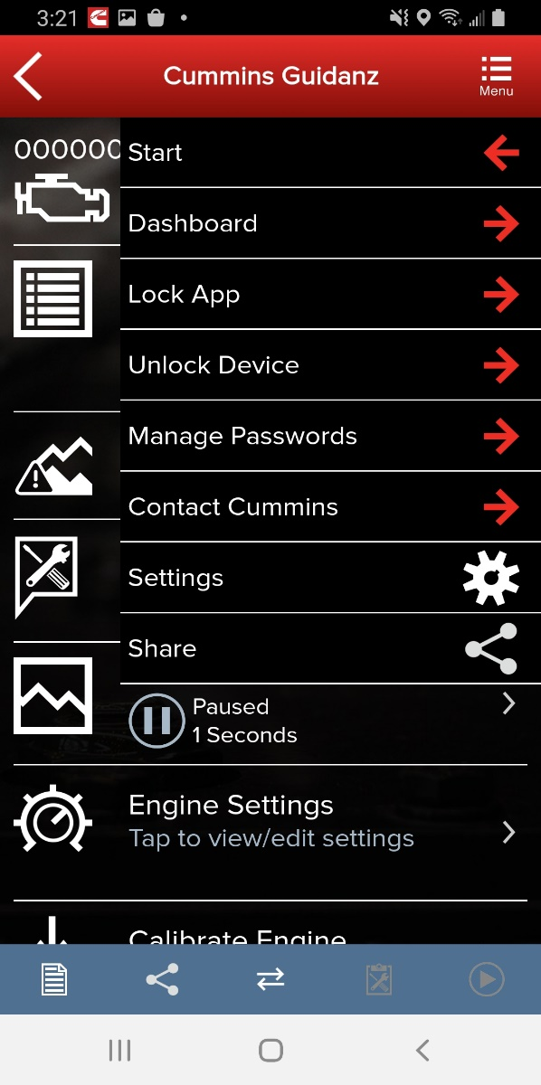
Equipment Dashboard (Equipment Summary Screen)
The equipment summary screen will show in different sections (if available):
Equipment Dataplate
Cummins Engines
Engine #1
Public Cummins Devices,
Route Parameter Manager
Acumen On-Board Data Logger
Smart Devices, etc.
Other Devices
Transmission
Brake Controller, etc.
A yellow indicator will show unsupported devices (e.g. Rombooted devices)
User can also get to the Equipment Dashboard by selecting Dashboard in the Menu button once user is in the Device Dashboard

Slide 42
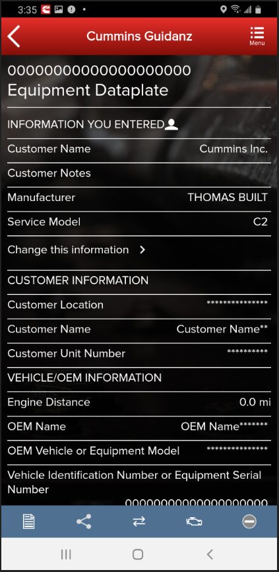
Equipment Dataplate
Equipment Dataplate can be accessed via the ECM Device Dashboard and Engine Dataplate
It contains the information the user enters such as customer name, manufacturer, model, etc., as well as other information

Slide 43
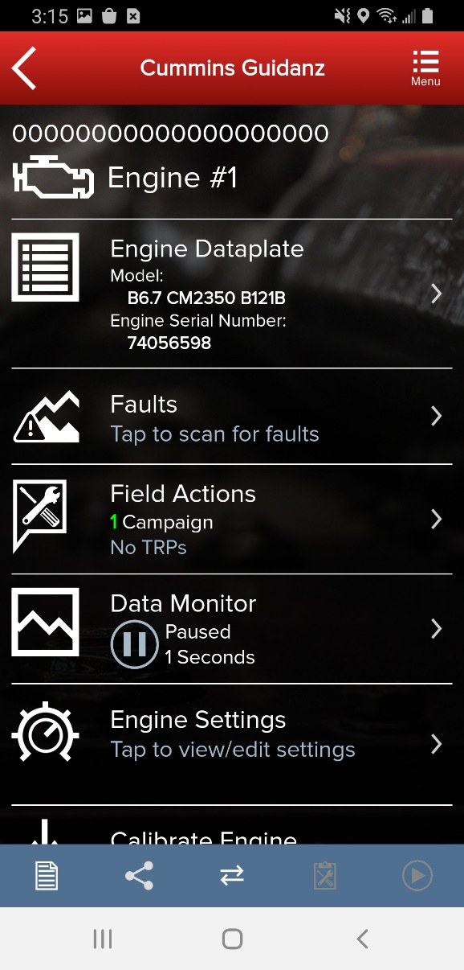
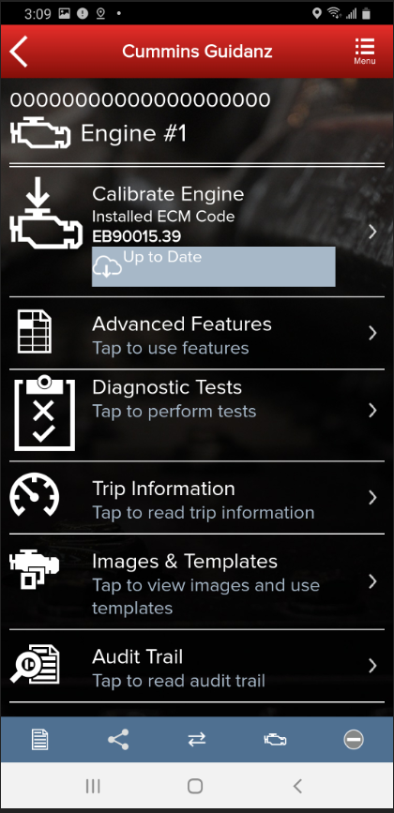
Device Dashboard
Clicking on a device on the equipment dashboard displays the device dashboard
The device dashboard screen shows all the functionality that is available for that device

Slide 44
Engine Dataplate
Engine Dataplate can be accessed via the ECM Device Dashboard
It contains the information read from the ECM, such as ECM information, Calibration information and Equipment information

Slide 45
ECM Fault Screens
Clicking on Faults on the ECM Device Dashboard displays the Faults and Analysis screen with primary faults, unprioritized faults, and related faults
Clicking on an individual Cummins fault code displays the Fault Details and, if supported, the fault snapshot
Clicking on a fault code number will open the respective Fault Information System (FIS) file in a web browser

Slide 46
Clear Fault Codes
To clear fault codes, click on the right-hand top Menu option and select Clear All Faults
After user confirms to Clear Faults Now, app continues to Key Off/Key On process
At the end of the process, app confirms Faults cleared successfully
If user Cancels, no faults will be cleared

Slide 47
Field Repair Actions
Field Repair Actions display the list of open Temporary Repair Practices (TRP) and Campaigns for the ESN of the connected engine.
Once user clicks on Field Actions the number of available Campaigns and TRPs will be displayed.

Slide 48
Data Monitor Logging (DML)
Clicking on Data Monitor on the ECM Device Dashboard takes the user to the Data Monitoring screen which allows the user to monitor and record parameters
When clicking on Monitor the user can monitor all parameters while ECM is running

Slide 49
Data Monitor Logging (DML)
When clicking on the green button, the Data Monitoring control screen is opened
The user can start and pause (stop) DML and change the time settings
When clicking on the Record button the user can record the parameters
While recording, each time the user clicks the Pause button or leaves the DML screen a record file is created and stored.

Slide 50
Data Monitor Logging (DML)
A user can use pre-defined groups with pre-defined parameters to monitor or record
A user can create and save a new custom group with parameters user selects (the parameters that are not currently supported are grayed out)
A user can add custom or pre-defined groups to Favorites

Slide 51
Engine Settings
Clicking on Engine Settings on the ECM Device Dashboard the user is taken to the Engine Settings screen where the user can see the values of each parameter.
User can view and edit System ID and Dataplate settings by clicking on System ID and Dataplate in the Engine Settings screen

Slide 52
Engine Settings
User can search the Engine Settings parameter list
User can change parameter and sub-parameter values that are not locked by changing the value within the specified min and max values

Slide 53
Engine Settings
After user confirms the changes, user can save changes
Changes are written to ECM by going through Key Off/Key On process
At the end of the process, saved changes are confirmed
If you move away from the screen without saving, the changes will be discarded

Slide 54
Calibrate Engine
The Calibrate Engine feature on the ECM Device Dashboard will display to the user whether or not the installed ECM code is up to date or whether there is a new revision of the ECM code available.

Slide 55
Calibrate Engine
If there is a new ECM code available, and the user clicks on the Calibrate Engine feature on the ECM Device Dashboard, the user will be taken through the process to upgrade to the latest ECM code revision.
Only for an ESN in campaign, if the calibration download fails or the ECM gets rombooted during the calibration download, the user can recover the ECM by going through the pre-defined steps using the same device and user login.

Slide 56
Calibrate Engine
Selecting “Calibrate Engine” will allow users to see calibrations on the device, and download new calibrations from the cloud.

Slide 57
Calibrate Engine
Calibrations are stored on the device can be used to update or change the calibration of an ECM

Slide 58
Calibrate Engine – Cal Assist
Changing the Base Calibration requires the use of a “CalAssist Unit”. These counts can be purchased from your distributor or the Cummins marketplace

Slide 59
Calibration Installation Process
The app will go through Steps 1 - 4 of the installation process.
Public

Slide 60
Calibration Installation Process
The app will go through Steps 1 - 4 of the installation process.
Public

Slide 61
Key Off Instructions
After completion of the 4 installation steps, the user is prompted to key off. A timer will count down. Its length is determined by the engine type.
Public

Slide 62
Key On Instructions
After the timer reaches 0, the user is prompted to key back on, at which time the app is reconnecting to the ECM.
Public

Slide 63
Calibration Installation Success
The app will inform the user whether the installation was successful.
Public

Slide 64
Advanced Features
Clicking on Advanced Features on the ECM Device Dashboard the user is taken to the Advanced Features screen where the user can see the supported Advanced Features.
If supported by the calibration, following Advanced Features have been implemented:
Engine Protection
Duty Cycle Monitor
SAE J1939 Powertrain Control
SAE J1939 Multiplexed Fault Data
Engine Torque History
Aftertreatment History
Aftertreatment Particulate Matter Sensor Regeneration
Aftertreatment SCR Catalyst Cold Soak Override
Aftertreatment SCR Maintenance
Aftertreatment SCR Regeneration History
Immobilizer Installation
Rated Overspeed Protection
Stop Start Active Inhibit Monitor
User can also manage Advanced Features by adding them to the Favorites list.

Slide 65
Advanced Features – ECM data Extraction
From the Advanced Features screen where the user can see the supported Advanced Features, select ECM Data Extraction
The ECM Data Extraction process can take up to 20 minutes to complete

Slide 66
Diagnostic Tests
Clicking on Diagnostic Tests on the ECM Device Dashboard the user is taken to the Diagnostic Tests screen where the user can see all the diagnostic tests implemented in the Guidanz Mobile app and if supported by the calibration.

Slide 67
Diagnostic Tests
Implemented diagnostic tests (if supported by calibration in ECM)
Cylinder Cut-out Test
Fan Override Test
Solenoid Click Test
Engine State Monitor
Aftertreatment SCR System Test (SPT2)
Electronic Fuel Control Actuator Override Test
Aftertreatment Current Based Particulate Matter Sensor Regen
Injector Check Valve Diagnostics Test
Aftertreatment Diesel Exhaust Fluid System Leak Test
Starter Lockout Relay Driver Override Test
Intake Air Heater Override
Aftertreatment Diesel Particulate Filter Regeneration Test
Fuel System Leakage Test
Diesel Exhaust Fluid Doser Pump Override Test
Fast Idle Warmup Test
VGT Hysteresis Test
High NOX reset
Fuel Level Override Test
Fuel Injector Performance Test
Electric Fuel Lift Pump Override Test
Aftertreatment Diesel Particulate Filter Restriction Test
Aftertreatment Diesel Exhaust Fluid Pump Heater
Aftertreatment SCR Catalyst Desulphurization

Slide 68
Diagnostic Tests
Implemented diagnostic tests (if supported by calibration in ECM)
Switch and Sensor Intermittent Connection Test
Aftertreatment Diesel Exhaust Fluid System Leak Test
Aftertreatment Diesel Particulate Filter Deep Clean Regeneration
Aftertreatment SCR performance test.
Aftertreatment SCR System cleaning test
Cylinder Performance Test​
Gas Throttle Control Test
SAE J1939 Datalink Control Test
Engine Protection Witness Test
Setup for Dynamometer
Diesel Exhaust Fluid Doser System Heater Test
VGT Electronic Actuator Install and Calibration
Cylinder Bank Cutout Test
Engine Fuel Supply Pump Override Test
Engine Priming Pump Override
Heated Oxygen Sensor Test
High Pressure Fuel System Actuator Override Test
Open Loop Mode Lock-In Test
Shut Off Valve Solenoid Actuator Test
Single Bank Cutout Test
Aftertreatment Hydrocarbon Doser System Test
Charge Throttle Actuator Test
Fuel Control Valve Test

Slide 69
Diagnostic Tests
Implemented diagnostic tests (if supported by calibration in ECM)
Aftertreatment Engine Out NOx Sensor Test
Aftertreatment Inducement Witness Test.
Aftertreatment System Out NOx Sensor Test
Compressor Bypass Valve Test
EGR Delta Pressure Auto Zero Test
Exhaust Throttle Auto Zero Test

Slide 70
Diagnostic Tests
When clicking on a specific diagnostic test in the Diagnostic Tests screen the user is taken to the selected diagnostic test with instructions, possibly indicators with check boxes, and the status box.
The user should follow the pre-conditions outlined in the Instructions section before trying to start any diagnostic test in order to avoid any issues with starting or running the diagnostic test.

Slide 71
Diagnostic Tests
The user can go to the diagnostic test controls screen by clicking on the red button in the Chyron

Slide 72
Diagnostic Tests
The Diagnostic Test Controls chyron allows the user to start and stop the test
The Status box displays the diagnostic test status.

Slide 73
Trip Information
Clicking on Trip Information on the ECM Device Dashboard the user is taken to the Trip Information screen where the user can chose the required trip information
User can enable the trip fuel report
User can reset the trip information

Slide 74
Images & Templates
Clicking on Images & Templates on the ECM Device Dashboard the user is taken to the Images and Templates screen where the user can manage available Images or Templates
Clicking on Images shows all captured images for the connected ESN
User can also search the Images or change the Sort order

Slide 75
Images & Templates
Clicking on an image allows the user to connect to the ECM image which disconnects the user from Engine #1
Clicking on the three dots on the left-hand side of the ECM image allows the user to Convert to Template, Share EIF File, and Delete File
Currently, ECM images created in INSITE can be imported into Guidanz Mobile app, but ECM images created in Guidanz Mobile app cannot be imported into INSITE

Slide 76
Images & Templates
When user selects to convert image to template, user can change template name and enter template notes
Once the template has been created successfully, the user can write it to the ECM
The user is then taken through the Key Off/Key On process to save the template to the equipment

Slide 77
Images & Templates
To send an image to another user, in History and Templates click on Images
Go to the image user wants to share
Click on the three dots to the left of the image
Select Share EIF File
Select the default email client to send to another user

Slide 78
Images & Templates
To receive a image to import into Guidanz Mobile app, open an email client
Select the email and click on the image in eif format
If available, click on Copy to Guidanz, or search for the app through More options to import
The user is then asked to Import

Slide 79
Images & Templates
User will then see Image Properties
User can change ECM Image name and Technician Notes
If image was imported successfully, user will receive a notification

Slide 80
Audit Trail
Clicking on Audit Trail on the ECM Device Dashboard the user is taken to the Audit Trail screen where the user can see the audit trail of the connected ECM

Slide 81
Calibration Files – Viewing calibrations on the device
Selecting “Calibration Files” will allow the user to view calibrations, the revision history, properties, and delete calibrations that have been downloaded to the device.

Slide 82
Calibration Files - Search
Selecting “Search Online” will allow the user to enter a base calibration and search for the latest revision.

Slide 83
Calibration Files – Download to device
After searching, users have the option to view the revision history, or download the calibration to their device.

Slide 84
History and Templates (Event Folder)
User can access the History and Templates folder from the Home screen. The user can go to History and Templates and find
ECM Images
Templates
In each work order, user can find
ECM Images
DML Log files
Calibration Log File
Trim Recovery File
which can be shared or deleted by the user.
Public

Slide 85
Device notifications
If the user gets locked out during an operation, both the device and the app will inform the user of the operation through background notification.
Public

Slide 86
Auto-Update of the app
In iOS:
Go to Settings and Enable the Updates option
In Android:
Open Google Play app
Activate the Auto-update apps option
Public

Slide 87
Engines not supported
Engine Program | ECM |  | Engine Program | ECM
480C-E | CM552 |  | ISM | CM570
B5.9G | CM420 |  | ISM - CM870 | CM870
C Gas Plus/B Gas Plus | CM556 |  | ISM - CM875 | CM875
C8.3G | CM420 |  | ISM - Fuel Control Module - CM570 | CM570
CELECT | ECM-B |  | KTA19, G855 CM558 G Drive | CM558
CELECT Plus | ECM-C |  | L Gas Plus | CM556
CELECT Plus Industrial | ECM-C |  | L10G | CM420
Centinel | CM400 |  | PIM | CM550
CENTRY | CM400 |  | QSB5.9/44, 5.9/30, 4.5/30, 3.9/30 | CM550
Gas Compression GTA3.9/5.9/8.3GC, KTA19/38GC - SSM558/CM556/CM2358 | CM556 |  | QSC8.3/QSL9 | CM554
 | SSM558 |  |  | CM500
ISB | CM550 |  | QSK19/23/45/60/78 | CM500
ISB - CM850 | CM850 |  | QSK19G/38G/60G, QSV81/91 - CM700/SSM558/CM2358 | CM700, SSM558
ISB Daimler Chrysler | CM551 |  |  | CM2358
ISBe (4 and 6 Cylinder) | CM800 |  | QSM11 | CM570
ISBe2/3 - CM850 | CM850 |  | QST30 | CM552
ISBe4 (4 and 6 cylinder) | CM850 |  | QST30 - Power Gen | CM552
ISC / Transit Bus ISL8.3 - CM850 | CM850 |  | QSX15 | CM570
ISC/ISL | CM554 |  | Signature/ISX | CM570
ISL8.9 - CM850 | CM850 |  | Signature/ISX - CM870 | CM870
ISLe4 (6 cylinder) | CM850

Slide 88
Questions or Issues
Please contact Cummins Care for any questions or issues
Call: 1-800-CUMMINS
Email: ServiceToolSupport@cummins.com
Chat Service: www.cummins.com
Tool Support Website: www.cummins.com
Public

